Slide 1
Theology Refresher 2019
“The Human condition” and Cultural Controversy
Article 3
EDA
Riverstone Church
Gregory C. Strand
March 15 – March 16, 2019

Slide 2
Introduction

Slide 3
An Interview with Lauren Daigle on the Dominick Nati Show
DN: "I hate to do this to you Lauren but I usually ask tough questions so is that alright if I ask just a couple of ones that are tougher and you can let me know if you wanna answer them?
LD: "Ok, cool."
DN: "Well, just 'cos we were talking about Ellen [DeGeneres] ...do you feel that homosexuality is a sin?"

Slide 4
LD: "You know I can't honestly answer on that...I have too many people that I love that, they are homosexual, I don't know. I actually had a conversation with someone last night about it and I was like 'I can't say one way or the other, I'm not God'. So, when people ask questions like that that's what my go to is. I just say read the Bible and find out for yourself and when you find out let me know 'cos I'm learning too."

Slide 5
Boy Or Girl?
The single most common question Victor gets asked is "Are you a boy or are you a girl? " Their answer to this question is “No”, which is rather confusing for some people. They are Non Binary, and that means they identify as something other than male or female. Victor breaks down why they see the obsession with gender and genitals as outdated: "Gender is what you feel, not what your parts are!"

Slide 6
“No . . . I am non-binary. . . . Gender is in the brain. Physical sex is a completely separate and different thing. . . . Gender is what you feel, not what your ‘parts’ are – it doesn’t matter what meat skeleton you’ve been born in, it’s what you feel that defines you.”

Slide 7
1. What does it mean that we are created beings?
2. What does it mean and what is the significance that Adam and Eve, the man and the woman, male and female, are created in the image of God, the imago Dei? Who determines that?
3. What are the similarities and differences between Adam and Eve, the man and the woman, male and female? Who determines that?
4. Is there a difference between human nature and identity? If so, what is it and how is it determined?

Slide 8
5. How does culture affect, influence or determine our understanding of this?
6. How does the imago Dei serve as the ground for LGBTQIA+, and how does the present cultural pressure affect God’s divine design for male and female, men and women? How much of this is grounded in the notion of “social contagion”?
7. How has the image of God in humanity been affected by sin? How is this understood or explained? How is this manifested today? How is it addressed?
8. With a biblical understanding of the image of God, how do we think about and process bioethical matters, such as Artificial Reproductive Technologies (ART), CRISPR (clustered regularly interspaced short palindromic repeats [gene-editing]), human enhancement, and other issues?

Slide 9
9. How do we think about technology and its affect, both good and bad, on humanity and how it builds into or destroys the imago Dei?
10. Is Artificial Intelligence (AI) good or bad? How does this affect human beings? How does it enable us to image and reflect God?
11. Is all technology good and ought to be pursued, a mentality of because we can, we should? How is the drive for transhumanism grounded in the image of God? What might this mean for the next step, that of posthumanism?
12. Since the dignity of all human beings is foundational to the image of God, why is there still so much racial prejudice and racial unrest, even among Christians?

Slide 10
13. What destructive effects does pornography have on the image of God in oneself, in another?
14. In marriage, a biologically sexed man and woman become one flesh which is a permanent, life-long covenant between one another before God, and yet, what does divorce do to the image?
15. Because of the image of God in all human beings, and grounded in divine design between men and women, i.e., there are differences – not duplicates – which are very good, how is this lived out in the home, in the church? And why is there abuse, and how are we to think of #MeToo and #ChurchToo and Toxic masculinity?
16. With the image of God guiding our thinking and living, what should we do as we ponder abortion, infanticide (fourth-trimester abortion), euthanasia, physician assisted suicide, Alzheimer’s victims, disability, etc.?

Slide 11
17. With our God-given image and dignity given to all, does that dignity terminate in death, or does that dignity continue and how is that reflected, viz., in death, should the body be buried or cremated, or does it even matter?

Slide 12
Doctrine of Humanity: Questions (Millard Erickson, Christian Theology)
1. How does the doctrine of humanity relate to the person of Christ?
2. What is humanity’s crisis in self-understanding?
3. How have society’s views of the images of humanity affected its perspective on human nature?
4. What similarities and differences do you discover between the secular images of humanity and the Christian view of humanity? How do you evaluate each perspective? What does it mean to be made in the image of God?

Slide 13
The doctrines of Christian theology are organic, related and interrelated. Why is the doctrine of humanity especially important?
1. This doctrine is important because of its relationship to other major Christian doctrines.
2. The doctrine of humanity is a point where the biblical revelation and human concerns converge.
3. The doctrine of humanity is particularly significant in our day because of the large amount of attention given to humanity by the various intellectual disciplines.

Slide 14
4. The doctrine of humanity is important because of the present crisis in human self-understanding.
5. This doctrine also affects how we minister.

Slide 15
One New Testament scholar writes the following, which gives the proper context in which to think about issues and trends:
  What is "on the horizon" looks different in different denominations, in different parts of the country, in different demographic sectors even within the church. As for the greatest needs, the ones of which I am most certain are the perennial ones: the centrality of the gospel, such Spirit-empowered transformation that we love holiness, death to self-interest, the importance of the local church, and the like. The particular pressures against these important and urgent needs vary quite a bit, but the central needs themselves do not change very much. And if we think they do, we are probably in danger of being seduced by relatively secondary things.

Slide 16
EFCA Statements on Human Sexuality:
A 2013 resource for EFCA pastors and churches has been written by the EFCA Spiritual Heritage Committee.
https://www.efca.org/resources/announcement/church-statement-human-sexuality
EFCA Conference Resolution: Biblical Sexuality and the Covenant of Marriage (2017)
https://www.efca.org/resources/document/efca-conference-resolution-biblical-sexuality-and-covenant-marriage
Audio:
Mark Yarhouse on Gender Dysphoria (last 3 lectures on this page):
https://www.efca.org/2016-theology-conference-doctrine-church
Wesley Hill's personal testimony "Washed and Waiting" at the EFCA Theology Conference in 2013.
https://www.efca.org/podcasts/episodes/episode-117-washed-and-waiting-personal-testimony-theological-and-ecclesial

Slide 17
Articles:
"A Letter to My Brothers" by Beth Moore
https://blog.lproof.org/2018/05/a-letter-to-my-brothers.html
"My Trainwreck Converstion" by Rosaria Butterfield
https://www.christianitytoday.com/ct/2013/january-february/my-train-wreck-conversion.html
"How Martina Navratilova Found Herself ‘On the Wrong Side of History’ in a Hurry" by Al Mohler
https://albertmohler.com/2019/02/21/martina-navratilova-found-wrong-side-history-hurry/
EFCA Reviews of "Understanding Gender Dysphoria"
https://www.efca.org/blog/theology-culture/book-review-understanding-gender-dysphoria
Posts by Greg Strand about Mark Yarhouse
http://strands.blogs.efca.org/tag/mark-yarhouse/
"Status Confessionis: The State of the World, in Which the Church Must Stand by Her Confession" - Harold O.J. Brown
http://www.touchstonemag.com/archives/article.php?id=12-03-036-f
"A Status Confessionis Issue" by Kevin DeYoung
https://www.thegospelcoalition.org/blogs/kevin-deyoung/a-status-confessionis-issue/
Christopher Yuan reviews Matthew Vines' book, "God and the Gay Christian" with strong disagreement.
https://www.christianitytoday.com/ct/2014/june-web-only/why-matthew-vines-is-wrong-about-bible-same-sex-relationshi.html
A debate between Matthew Vines and Caleb Kaltenbach.
https://www.nytimes.com/interactive/2015/06/05/us/samesex-scriptures.html

Slide 18
Books:
Sam Allberry, Is God Anti-Gay?: And Other Questions About Homosexuality, the Bible and Same-Sex Attraction (2013) and 7 Myths About Singleness (2019)
Ryan T Anderson, When Harry Became Sally: Responding to the Transgender Moment (2018)
G. K. Beale, We Become What We Worship: A Biblical Theology of Idolatry (2008)
Denny Burk and Heath Lambert, Transforming Homosexuality: What the Bible Says about Sexual Orientation and Change (2015)
Rosaria Butterfield, Openness Unhindered: Further Thoughts of an Unlikely Convert on Sexual Identity and Union with Christ (2015) and The Gospel Comes with a House Key: Practicing Radically Ordinary Hospitality in Our Post-Christian World (2018)
Kevin DeYoung, What Does the Bible Really Teach about Homosexuality? (2015)
Robert A. J. Gagnon, The Bible and Homosexual Practice: Texts and Hermeneutics (2001)
Andrew Goddard and Don Horrocks, ed., Biblical and Pastoral Responses to Homosexuality: Resources for Church Leaders (2012)
Wesley Hill, Washed and Waiting: Reflections on Christian Faithfulness and Homosexuality (2010)
Anthony A. Hoekema, Created in God's Image (1994)
Dennis Hollinger, The Meaning of Sex: Christian Ethics and the Moral Life (2009)
John Kilner Dignity and Destiny: Humanity in the Image of God (2015)
Richard Lints, Identity and Idolatry: The Image of God and Its Inversion (2015)
Al Mohler, ed., God and the Gay Christian?: A Response to Matthew Vines (2014)
Nancy R. Pearcey, Love Thy Body: Answering Hard Questions about Life and Sexuality (2018)
Jackie Hill Perry, Gay Girl, Good God: The Story of Who I Was, and Who God Has Always Been (2018)
David Peterson, ed., Holiness and Sexuality: Homosexuality in a Biblical Context (2004)
Vaughn Roberts, Transgender: Christian Compassion, Convictions and Wisdom for Today’s Big Questions (2016)
Brian S. Rosner, Known by God: A Biblical Theology of Personal Identity (2017)
Klyne R. Snodgrass, Who God Says You Are: A Christian Understanding of Identity (2018)
Andrew Walker, God and the Transgender Debate: What does the Bible Actually Say About Gender Identity? (2017)
Mark A. Yarhouse, Understanding Gender Dysphoria: Navigating Transgender Issues in a Changing Culture (2015)
Christopher Yuan, Out of a Far Country: A Gay Son's Journey to God. A Broken Mother's Search for Hope (2011) and Holy Sexuality and the Gospel: Sex, Desire, and Relationships Shaped by God’s Grand Story (2018)

Slide 19
Image of God:
Biblical Texts

Slide 20
Genesis 1:26-27: ²⁶ Then God said, "Let us make man in our image, after our likeness. And let them have dominion over the fish of the sea and over the birds of the heavens and over the livestock and over all the earth and over every creeping thing that creeps on the earth."
²⁷ So God created man in his own image, in the image of God he created him; male and female he created them.
Genesis 5:1-2: This is the book of the generations of Adam. When God created man, he made him in the likeness of God. ² Male and female he created them, and he blessed them and named them Man when they were created.
Genesis 9:6: ⁶ "Whoever sheds the blood of man, by man shall his blood be shed, for God made man in his own image.

Slide 21
1 Corinthians 11:7: ⁷ For a man ought not to cover his head, since he is the image and glory of God, but woman is the glory of man.
James 3:9: ⁹ With it we bless our Lord and Father, and with it we curse people who are made in the likeness of God.

Slide 22
Acts 17:28: ²⁸ for "'In him we live and move and have our being'; as even some of your own poets have said, "'For we are indeed his offspring.'
Romans 8:29: ²⁹ For those whom he foreknew he also predestined to be conformed to the image of his Son, in order that he might be the firstborn among many brothers.
2 Corinthians 3:18: ¹⁸ And we all, with unveiled face, beholding the glory of the Lord, are being transformed into the same image from one degree of glory to another. For this comes from the Lord who is the Spirit.
Ephesians 4:23-24: ²³ and to be renewed in the spirit of your minds,
²⁴ and to put on the new self, created after the likeness of God in true righteousness and holiness.

Slide 23
The Human Condition
3. We believe that God created Adam and Eve in His image, but they sinned when tempted by Satan. In union with Adam, human beings are sinners by nature and by choice, alienated from God, and under His wrath. Only through God’s saving work in Jesus Christ can we be rescued, reconciled and renewed.

Slide 24
God’s gospel alone addresses our deepest need

Slide 25
“When I consider your heavens, the work of your fingers, the moon and the stars, which you have set in place, what is man that you are mindful of him, the son of man that you care for him?” (Ps. 8:3-4)

Slide 26
I. The Source of Human Dignity: Our creation in God’s Image

Slide 27
“Again, it is certain that man never achieves a clear knowledge of himself unless he has first looked upon God’s face, and then descendes from contemplating him to scrutinize himself.” Calvin, Institutes (1.1.2)

Slide 28
Then God said, “Let us make man in our image, in our likeness, and let them rule over the fish of the sea and the birds of the air, over the livestock, over all the earth, and over all the creatures that move along the ground.” So God created man in his own image, in the image of God he created him; male and female he created them… God saw all that he had made, and it was very good. (Gen. 1:26-27,31)

Slide 29
Here is the source of all human dignity and significance and the place where the sanctity of human life is rooted. Of all the creatures on the earth, only human beings are created in the image of God. Man is a creature of great majesty, but it is a derived dignity, a God-given greatness. According to the Bible, human beings must be defined in terms of their relation to God – as the image of God.

Slide 30
A. Human Beings as God’s Image

Slide 31
Human beings are rational beings able to think and to seek truth; we are moral beings, able to make judgments about good and evil; we are social beings, able to communicate and to love; we are artistic beings, able to create and to appreciate beauty; and we are spiritual beings, able to worship and to pray.

Slide 32
All these qualities point to the uniqueness of human beings in creation as persons who think, feel, speak, make free decisions, and moral judgments, and who long to know and be known, to love and be loved.

Slide 33
The Bible’s reticence to define the image of God in functional terms should alert us to the danger of denying the true humanity of any who are in any way deficient in normal human functions. For this reason we concur with the judgment of Millard Erickson when he concludes, “The image . . . Refers to something a human is rather than something a human has or does. By virtue of being human, one is in the image of God; it is not dependent upon the presence of anything else.”

Slide 34
As persons we are engaged in relationships, and our creation in God’s image suggests relationships in two-directions.

Slide 35
First, and most obviously, our creation in God’s image entails a relationship with God himself. To be a human being is to be directed toward God. We are created by God; we are dependent on God; we are responsible to God. All other relationships are to be dominated and regulated by this one overarching reality – we are made for relationship with God.

Slide 36
This suggests that human beings not only reflect God in the world, they also represent him.

Slide 37
This aspect of the image of God comes out in the command for man to rule over creation (Gen. 1:26) and is illustrated in the task given to Adam of naming the animals in Genesis 2. Human beings are to “subdue” God’s creation, in the sense of “having dominion” over it (1:28), and God put Adam in the garden to “work” in it and “to take care of it” (2:15).

Slide 38
Because human beings are the image of God, they ought also to be honored appropriately. One honors God by honoring his image. For this reason Jesus links the command to love God with the command to love one’s neighbor, who is created in the image of God. Love for one’s neighbor demonstrates love for God.

Slide 39
The fact that murder is considered to be a capital crime is also grounded in this connection. . . . We encounter God as we encounter other human beings . . . We cannot hate the image and say we love the One it represents.

Slide 40
The Bible affirms that every human being is created in the image of God, not just the kings, as was believed in many ancient cultures.

Slide 41
All human life – at whatever stage of development, from conception to death; at whatever socio-economic status; and at whatever level of physical or intellectual capability – is sacred, because all human beings are created in God’s image. Even when this image has been corrupted by our sin, every human being is still worthy of honor and respect. There is nothing more valuable than a human life.

Slide 42
This corruption is assumed in the need for the renewal of he image (Col. 3:10) and our need to be conformed to the image of Christ (Rom. 8:29; 2 Cor. 3:18) who is the image of God (Col. 2:4).

Slide 43
B. The Significance of Adam and Eve

Slide 44
“from one man [God] made every nation of men, that they should inhabit the whole earth” (Acts 17:26).

Slide 45
As an expression of the incompleteness of creation, God declared that it was not good for Adam to be alone (Gen. 2:28). The first man was joined by the first woman, Eve, and the design of God to create “man” in his own image as male and female was complete (Gen. 1:27).

Slide 46
This “gendered” creation is significant in several ways. First, it points to the essentially relational nature of human existence. Adam’s solitary life called for a partner – “a helper suitable for him” (Gen. 2:28). To be fully human, we have a need for social interaction with other human beings.

Slide 47
Second, the Genesis account assumes the equal value of men and women. Each is created in God’s image. We find no biblical grounds for an oppressive patriarchy.

Slide 48
Third, while affirming the equal significance of man and woman as creatures uniquely created in the image of God, the Bible also affirms their differences. Paul draws on the fact that Adam was created first to ground some instructions regarding behavior in the assembly of the church (cf. 1 Cor. 11:3-10; 1 Tim. 2:8-15).

Slide 49
Fourth, our gendered creation reflects the divine command to “be fruitful and increase in number” (Gen. 1:28), part of God’s original blessings of the first human beings. Procreation in the context of the marriage relationship, is part of the goodness of God’s design for human life.

Slide 50
Finally, the creation of human beings as male and female also reinforces the notion of a created order, particularly as it points us to the marriage relationship. This is reflected in the culmination of Genesis 2 and reaffirmed by Jesus (Matt. 19:3-9), and Paul speaks to what is contrary to this natural order (Rom. 1:26-27). God has created us as male and female, and this difference is significant and ought to be recognized and valued.

Slide 51
Male and female relationships are, of course, also significant in discussions of the roles of husbands and wives in the New Testament, though there is no reference to creation in those passages (cf. Eph. 5:22-33; Col. 3:18-19; 1 Pet. 3:1-7) as is the case in discussing certain aspects of the life in the church in 1 Cor. 11:3-10; 1 Tim. 2:8-15.

Slide 52
There are some legitimate differences of opinion about how one understands the nature of the language used in the early chapters of Genesis to describe the actions of God in the world. However, our Statement affirms that Adam and Eve were historical figures in the following sense:

Slide 53
1) From these two all other human beings are descended (Acts 17:26). [The historical reality of Adam and Eve has been the traditional position of the church (so Tertullian, Athanasius, Augustine, Calvin) and is supported elsewhere in Scripture. Particularly Paul compares the “one man” Adam with both Moses and Jesus (cf. Rom. 5:12, 15-19; 1 Cor. 15:20-22). In addition, Luke traces the genealogy of Jesus back to Adam (Luke 3:23-37; cf. also 1 Chron. 1).]

Slide 54
2) These two were the first creatures created in God’s image such that they were accountable to God as responsible moral agents.
3) These two rebelled against God, affecting all their progeny. [Consequently, no human beings existed prior to these two, and, consequently, no human beings were sinless and without the need of a Savior.]

Slide 55
What is essential to the biblical story-line is that the problem with the world is not ontological – that is, it is not a result of the material nature of creation itself nor is sin an essential part of our humanity. The problem is moral. The first human beings from the very beginning in a distinct act of rebellion, chose to turn away from God, and this act not only affected all humanity (cf. Rom 5:12-21), but creation itself (cf. Rom. 8:18-25).

Slide 56
II. The Source of Human Depravity: Our Fall into Sin

Slide 57
Our Statement of Faith follows the biblical story, moving from the glory of Genesis 2 to the guilt of Genesis 3. The man and his wife were both naked, and they felt no shame as they enjoyed the blessing of God in the garden he had created for them. A tempter – Though his existence is real, his origin is unknown; he is depicted simply as a serpent, a snake – a mere creature.

Slide 58
A. Tempted by Satan

Slide 59
However they originated, the Bible affirms the reality of evil spiritual beings, led by Satan, the tempter and accuser, and a liar and murderer from the beginning (John 8:44). He remains our greatest enemy, though he was defeated by Christ on the cross and will be banished forever when Christ returns in glory, and every enemy is put under his feet and he finally “turns the kingdom over to God” (I Cor. 15:24).

Slide 60
The first humans, Adam and Eve, were created able to sin (posse peccare). After the fall human beings are born “in Adam” and are captive to sin – not able not to sin (non posse non peccare). Redeemed in Christ, the second Adam, believers are able not to sin (posse non peccare). Finally in glory, believers will, like Christ, not be able to sin (non posse peccare).

Slide 61
In his craftiness, the serpent first casts doubt on the word of God, introducing the first questioning of God’s character in the world: “Did God really say, ‘You must not eat from any tree in the garden’?” (Gen. 3:1).

Slide 62
Then the serpent attacks God’s truthfulness: “’You will not surely die,’ the serpent said to the woman” (3:4), suggesting that sin will not be judged.

Slide 63
Finally, in verse 5 he casts doubt on God’s goodness in making this prohibition: “For God knows that when you eat of it your eyes will be opened, and you will be like God, knowing good and evil.”

Slide 64
The temptation had its intended effect. “When the woman saw that the fruit of the tree was good for food and pleasing to the eye, and also desirable for gaining wisdom, she took some and ate it. She also gave some to her husband, who was with her, and he ate it” (v. 6). The temptation of the serpent was not the cause of Eve’s choice, simply the occasion for it.

Slide 65
B. The Nature of Sin

Slide 66
The “knowledge” of good and evil refers to deciding or determining what is good and evil, a prerogative that rightfully belongs to God alone. To disobey God and to eat of that tree was a rejection of God’s rule and authority. It was nothing less than an act of cosmic treason again the King of the universe.

Slide 67
The most common, hamartia, suggests that sin is the missing of a target or a failure to reach a goal. Two others, adikia (“unrighteousness”) and ponēria (“wickedness, evil”), depict sin as an inner corruption of character.

Slide 68
Two more active words, parabasis and paraptōma, speak of sin as a deliberate trespass, a stepping over a known boundary, while still another, anomia, is more explicitly the violation of a known law.

Slide 69
John Stott writes, “Sin is the revolt of the self against God, the dethronement of God with a view to the enthronement of oneself. Ultimately, sin is self-deification, the reckless determination to occupy the throne which belongs to God alone.”

Slide 70
III. The Continuing Effects of Sin: Our Union with Adam

Slide 71
For the first time Adam and Eve experienced shame, and they clothed themselves. In fear they hid from God. The intimate transparency of loving relationships was shattered.

Slide 72
The intimate transparency of loving relationships was shattered. When confronted with their sin, they each sought to evade responsibility. But they were responsible, and the Lord cursed them, expressing his judgment upon them for their act.

Slide 73
They were banished from the garden, and the flaming sword which guarded the way back to the tree of life signified their alienation from God and his holy wrath against them (cf. Gen. 3:24). . . . More important still were the continuing effects of sin.

Slide 74
This is the legacy of the sin of Adam, a legacy which theologians call the fall. The sin of Adam corrupted God’s good creation and unleashed the power of sin and death in the world, and this has affected us all.

Slide 75
We refer to the sin of Adam (and to our union with Adam) without reference to Eve because of the way the Apostle Paul links our condition especially to Adam (cf. Rom. 5:12-21; 1 Cor. 15:21-22). Paul knows that Eve sinned first (2 Cor. 11:3; 1 Tim. 2:14), but he gives Adam a status in salvation history that is not tied to temporal priority.

Slide 76
Somehow that sin of Adam has affected us all. The corruption of his nature that resulted from his sin is imparted to all his posterity. Our union with Adam is the ultimate source of the universality of sin and death. (biological, “seminal headship,” “federal headship”)

Slide 77
A. Sinful by Nature and by Choice

Slide 78
This corruption of human nature is called original sin. It is original in that it is with us before we are born, and it is the soil out of which all our conscious sins arise. . . We are sinners by the nature we inherit and by the choices we make. Put simply, we sin because we are sinners.

Slide 79
1. The Breadth of Sin

Slide 80
The Bible affirms that the human culpability in sin is universal, with the one exception of Jesus Christ. The passages which speak of this all inclusive reality are many: “If you, O Lord, kept a record of sins, O Lord, who could stand?” (Ps. 130:3);

Slide 81
“Do not bring your servant into judgment, for no one living is righteous before you” (Ps. 143:2); “Who can say, ‘I have kept my heart pure; I am clean and without sin’?” (Prov. 20:9);

Slide 82
“for all have sinned and fall short of the glory of God” (Rom 3:23); “If we claim to be without sin, we deceive ourselves and the truth is not in us” (1 John 1:8).

Slide 83
“There is no one righteous, not even one; there is no one who understands, no one who seeks God. All have turned away, . . . there is no one who does good, not even one” (Rom. 3:10-12).

Slide 84
There is also the universal voice of conscience speaking to our own hearts. Something inside us testifies against us, and we feel we must do something to make things right. We are all guilty. Sin is universal.

Slide 85
This excludes any form of Pelagianism, a view which argues that Adam affected us simply by setting a bad example. Pelagius contended our wills are morally neutral and that by nature, though we are able to sin, we also have the power to do all that God requires of us. This view was condemned as heretical at the Council of Carthage in 418 and again at the Council of Ephesus in 431.

Slide 86
2. The Depth of Sin

Slide 87
Our heart is diseased and must be cured. Jeremiah speaks of it in this way: “The heart is deceitful above all things, and desperately corrupt; who can understand it?” (Jer. 17:9). In fact, Ezekiel says, our hearts of stone must be replaced with a heart of flesh (Ezek. 11:19; cf. Jer. 31:33).

Slide 88
In the New Testament Jesus says our evil deeds flow from an evil heart as surely as rotten fruit grows on a diseased tree (Matt. 12:33-35).Consider Paul’s description of the sinfulness of Jews and Gentiles alike with a chain of Old Testament texts using various parts of the body to emphasize the all-pervasive nature of sin’s corruption: “Their throats are open graves; their tongues practice deceit. The poison of vipers is on their lips. Their mouths are full of cursing and bitterness. Their feet are swift to shed blood; . . . . There is no fear of God before their eyes” (Rom.3:13-15,18; illustrating the truth of 3:10-12).

Slide 89
This deep pervasiveness of sin that results from the corruption of human nature is what theologians call “total depravity.” This doctrine does not mean that every person is as wicked as he or she can possibly be and engages in every possible form of sin.

Slide 90
Nor does it mean that the unbeliever is totally insensitive in matters of conscience or never does anything that is good and right before other people, or that sinful human beings cannot be fine citizens with high moral standards. God’s common grace is still at work, restraining human sin.

Slide 91
Total depravity simply means that everything we are and everything we do is somehow affected by our sin. . . . Consequently, total depravity implies the total inability on the part of the sinner to rescue himself from his sinful condition.

Slide 92
Paul says that in our natural state we were “dead in our transgressions and sins” (Eph. 2:1). No one can do anything that merits the moral favor of God (Rom. 3:20; cf. John 15:4-5). “For the mind that is set on the flesh is hostile to God; it does not submit to God’s law, indeed it cannot; and those who are in the flesh [that is, under the enslavement of sin] cannot please God” (Rom. 8:7-8). “All our righteous acts are as filthy rags,” Isaiah says (Isa. 64:6).

Slide 93
Evangelical theology, in all its various formulations, has affirmed both our total depravity in sin and our total inability to save ourselves. Without the gracious work of the Holy Spirit enabling a sinful human being to understand and believe the gospel, we are without hope.

Slide 94
This gracious work of the Holy Spirit can be understood in different ways. Reformed theologians prefer to speak of effectual grace, which they contend only comes to the elect. They believe that God’s effectual grace always has the desired effect and those in whom God’s Spirit works in this way will repent and believe the gospel. Arminian/Wesleyan theologians prefer to speak of prevenient grace which comes to all. They contend that prevenient grace enables all to respond to the gospel, but only some will.

Slide 95
Both views are to be distinguished from Semi-Pelagianism which admits that human moral abilities have been weakened by the fall (in contrast to Pelagianism [see note 34 above]) but denies that human beings have lost all ability to take initial steps toward salvation by their own efforts apart from God’s grace. Semi-Pelagianism was condemned at the Council of Orange (529).

Slide 96
B. Alienated from God

Slide 97
From the time of Adam’s exclusion from the garden, human beings have existed in a state of alienation from their Creator. Cut off from the real source of life and blessedness, human beings experience a state of spiritual death (Eph. 2:1,5; 4:18). “Once you were alienated from God and were enemies in your minds because of your evil behavior,” Paul writes (Col. 1:21; cf. Rom. 5:10). Our sin separates us from a holy God.

Slide 98
C. Under God’s Wrath

Slide 99
To refuse to acknowledge him as God and to give to another the honor rightly due him is idolatry, which is a personal affront to his majesty and glory. “The wrath of God is being revealed from heaven against all the godlessness and wickedness of men who suppress the truth by their wickedness,” Paul writes as he begins his exposition of the universal sinfulness of humanity (Rom. 1:18; cf. 1:18-3:20), “For although they knew God, they neither glorified him as God nor gave thanks to him, . . . they became fools and exchanged the glory of the immortal God for images” (Rom. 1:21,23).

Slide 100
This is the essence of human sin, and as sinners, Paul declares, we were “by nature objects of wrath” (Eph. 2:3), awaiting a “day of God’s wrath, when his righteous judgment will be revealed” (Rom. 2:5; cf. Rev. 6:17). Apart from Christ we stand under God’s wrath (Rom. 5:9; 1 Thess. 5:9) facing the prospect of eternal condemnation.

Slide 101
IV. Our Only Hope: God’s Saving Work in Jesus Christ – Rescued, Reconciled and Renewed

Slide 102
For the Christian, the human condition cannot be considered apart from Jesus Christ. Jesus is the perfect embodiment of the image of God in humanity. “He is the image of the invisible God,” Paul boldly declares of Jesus (Col. 1:15; cf. also 2 Cor. 4:4). Jesus, in his human nature, is what Adam and Eve were created to be. He revealed God in his incarnation; he lived in relationships of love with his heavenly Father and with his earthly neighbor; and he exercised his rule over the natural world so that even the wind and the seas obeyed him.

Slide 103
As the image of God, Jesus reveals God to us; and as the image of God, he shows us what all human beings were meant to be. Jesus is the full expression of the perfection God intended when he created man in his image. In answer to the question, “What is man?,” the Bible directs us to Jesus. Further, as the image of God, Jesus came to undo the sin of Adam. Paul points us to this glorious truth: “For just as through the disobedience of the one man the many were made sinners, so also through the obedience of the one man the many will be made righteous” (Rom. 5:19).

Slide 104
Jesus Christ, “the last Adam” (1 Cor. 15:45), came as God to be what man was meant to be. He came to undo the sin of Adam by his own obedience and to create a new humanity, a people redeemed by his death, who would follow him in their lives. “And just as we have borne the likeness of the earthly man, so shall we bear the likeness of the man from heaven” (1 Cor. 15:49). This is our hope! And this is our only hope

Slide 105
Jesus “rescues us from the coming wrath” (1 Thess. 1:10; 5:9). “There is now no condemnation for those who are in Christ Jesus” (Rom. 8:1).
We have been delivered from the condemnation our sins deserve and the moral captivity our sin creates (cf. e.g., Rom. 6:18). Through our Lord Jesus Christ, “we have now received reconciliation” (Rom. 5:11), for “God was reconciling the world to himself in Christ, not counting men’s sins against them” (2 Cor. 5:19). We now enjoy peace with God as our Father (Rom. 5:1; 8:16). And in Christ that corrupted image is being renewed into a new humanity, “created to be like God in true righteousness and holiness” (Eph. 4:24; Col. 3:10; 2 Cor. 4:16; cf. Rom. 8:29). Our great hope is that when he appears we shall be like him (1 John 3:2).

Slide 106
conclusion

Slide 107
In Jesus Christ, our God has come personally into this world to adopt us as his own. Our being created by God in his image and then our fall into sin together provide the key to the riddle of the human condition. They explain our origin, illuminate our present tragedy, and point us to our glorious destiny when we as Christians, rescued from God’s wrath and reconciled from our alienation with him, shall be fully renewed in the image of Jesus Christ.

Slide 108
Imago Dei, Human Sexuality, Culture and Identity

Slide 109
Charles Taylor gives a broad overview of the history of premodern, modern, and postmodern time periods and the prevailing worldview of each of those epochs: pre-Enlightenment was marked by the impossibility of unbelief; post-Enlightenment was marked by the possibility of unbelief; and late Modern is marked by the impossibility of belief. (For this summary, cf. Al Mohler, Preaching in a Secular Age)
What this means is that the ground for authority has shifted from faith (belief in something outside of oneself), to science (belief in something rational and objective, determined by the unbiased observer), to self (belief in oneself, which means truth is internal, privatized and individualistic).
This has huge implications to most everything we observe and experience in culture. This is what is behind the notion of same-sex marriage and gender fluidity, i.e., an individual person can determine what gender they choose to be. And one could add many other moral issues we are facing in the culture today.

Slide 110
Charles Taylor, Sources of the Self: The Making of the Modern Identity (1992), A Secular Age (2007). (These thoughts are a summary of Tim Keller’s lecture on Culture and Identity. This lecture was helpful in summarizing how we got to this postmodern, post-Christian day. It was also insightful in explaining our contemporary culture and the present-day notion of identity. For Christians, it is also important to address Christ and Identity, since being “in Christ” transforms everything. This was Keller’s following message.)
Taylor makes identity visible.
What is your greatest purpose? What is the highest good? Who gets to say you are living right? You are valued, legitimate, good? Who is your ultimate validator?
He considers three stages: early modern, Romanticism, and late modernity.

Slide 111
Carl Trueman, The West is a Third World Country: The Relevance of Philip Rieff
Philip Rieff (1922-2006) is another one who provides an assessment of culture, which helpfully sheds light on our cultural moment which enables us to understand and assess our present-day culture better. He is not a Christian. In fact, he is Freudian. But common grace has enabled him to place his finger on the pulse of culture in insightful ways. In particular, his two works The Triumph of the Therapeutic: Uses of Faith after Freud (1966) and his posthumously published work edited by Arnold M. Eisen and Gideon Lewis-Kraus, Sacred Order/Social Order: The Jew of Culture: Freud, Moses, and Modernity (2008) have been helpful. He provides a historical scheme for categorizing cultures (First, Second, and Third World cultures). The link to the article by Trueman reflects some of those helpful insights. In
In some ways, Rieff preceded some of the helpful work done by Charles Taylor: Sources of the Self: The Making of the Modern Identity (1992) and A Secular Age (2007). The latter has been influential to Tim Keller and others. For example, The Gospel Coalition published a response to the book, edited by Collin Hansen, Our Secular Age: Ten Years of Reading and Applying Charles Taylor (2017).
Evangelicals have heard much more about Taylor than they have about Rieff. I appreciate Keller using Taylor. And I also appreciate James K. A. Smith making Taylor more accessible in How (Not) To Be Secular: Reading Charles Taylor (2014). But I also am grateful Trueman is referencing Rieff.

Slide 112
In the first, early modern (16th-17 centuries), there is still belief in a sacred order, there are moral absolutes that come from outside of self. However, Descartes planted seeds that would bear fruit later: cogito, ergo sum (originally in French, je pense, donc je suis), “I think, therefore I am.” Although not denying objective, eternal truth, I, the self, am the determiner of truth, I am the strongest apologetic or validator.
In the second, the Romantic (18th century), there is still a sacred order outside and external to self, but the way you find it is deep in yourself, through feelings, emotions, self-expression. This is the way one connects to the cosmic order.
In the last, late modernity or postmodernity (19th-20th centuries), the process is complete. The heart determines the moral good. There is no moral good outside of the self. All moral value is socially constructed. One does not discern the good but determines the good. This reflects completely an internal self – you are the ultimate validator and determiner of the good, and not good.

Slide 113
So, what are the contrasts?
1. Determining the ultimate good moves from external to internal.
2. The things of life, the stuff that makes up the self, moves from duties to desires. You are your desire, self-worth is determined by self.
3. Rather than moving from the outside to the inside to align with the good, that is to align the heart and the self to the external moral order, the self determines right and wrong and then argues with the outside, the culture, to align with what is in that person’s heart, that person’s self.
4. You move from being validated by someone or something external to the self, to being your own validator. In the past it was believed that what would fix the world would be to align self with moral order outside of self. Today, it is giving every individual the freedom to be self. We need to be saved from the idea we need to be saved. Every culture imposes without telling or asking. The overarching narrative: sacrifice to be yourself.

Slide 114
Charles Taylor describes this day and today’s self in the following ways (cf., James K. A. Smith, How (Not) To Be Secular: Reading Charles Taylor, 140-143; cf. also Charles Taylor, A Secular Age (2007)): age of authenticity: spirituality is deinstitutionalized and is understood primarily as an expression of “what speaks to me,” which is reflective of expressive individualism buffered self: the self is insulated in an interior “mind,” no longer vulnerable to the transcendent or demonic expressive individualism: each one has his/her own way of realizing our humanity, and in order to be true to self, it must be lived out, expressed rather than conform to models imposed by others fragilization: in the face of different options, where people who lead “normal” lives do not share my faith, my own faith commitment becomes fragile, put into question, dubitable immanent frame : constructed social space that frames our lives entirely within a natural order (rather than supernatural spin: a construal of life within the immanent frame that does not recognize itself as a construal and thus has no room to grant plausibility to the alternative

Slide 115
Sam Allberry, Where to Find Hope and Help Amid the Sexual Revolution, considers Four Significant Cultural Changes
1. Our moral intuitions have changed.
2. Our view of minorities has changed.
3. Our view of sex and marriage has changed.
4. Our anthropology has changed.

Slide 116
Duke Kwon, Pharisees, Tax Collectors, and the Politics of Self-Righteousness
“When our basic identity (our life’s “confidence”) is rooted in ourselves, our hearts are essentially unstable and insecure. We’ll do anything to fortify our self-image, including tearing down the public image of — and the image of God in — others. That’s why the self-righteous heart is always condemning. It’s never satisfied with being “right”; it also always needs to prove that others are wrong.”

Slide 117
A. Trevor Sutton, “Inclined to Boast: Social Media and Self-Justification.” Concordia Journal (Winter 2019).
“Death is not a daily fear for most people in modern industrialized nations; the vast majority of people in developed nations begin each week assuming that they will survive to see the weekend. This deferment of death has diminished the urgency of the vertical realm and produced a greater regard for the horizontal realm. Contemporary culture says there is plenty of life standing between now and eventual death; being in right relationship with the world is far more pressing than being in right relationship with God.”
“Self-justification in the Late Middle Ages was about producing good works that one might offer to God in order to be deemed righteous; self-justification in the modern age is about producing good works that one might offer to oneself or the world in order to be deemed righteous.”

Slide 118
John Barclay (Paul and the Gift, 498–499) describes how the fear of judgment (on a horizontal level) has pervaded our current cultural moment:
“In an age when people fear the judgement of their peers far more than the judgment of God, we have become increasingly petulant, critical, even cruel and it’s proving hard to take…Our contemporaries are not now primarily trying to win the favor of God; they are trying to win the favor of one another. The judgement they fear is not the last judgement, but humiliating comments on social media.”

Slide 119
This has huge implications to most everything we observe and experience in culture. This is what is behind the notion of same-sex marriage and gender fluidity, i.e., an individual person can determine what gender they choose to be. And one could add many other moral issues we are facing in the culture today.

Slide 120
But it is easy to look out the window at unbelievers and the culture and easily find the fault lines or tectonic shifts of morality. As believers in the church of Jesus Christ, we also need to look in the mirror, since this is the same cultural water in which we swim, and are being influenced and affected. Think for a moment of how believers consider commitment to a local church. Many remain committed as long as it does not cost, or does not cross one in any way. Consider the pornography pandemic, with the accompanying loss of desire and passion for purity and holiness. This sin is compounded by the lack of any grief and repentance for this sin. The numbers of professing believers who divorce is increasing and it is appearing to be an increasingly acceptable sin. I understand there are legitimate biblical grounds for divorce. But too many of the divorces are not on biblical grounds, thus making it more normal or acceptable. And this is to be one of the key ways in which the gospel we affirm is expressed in practice.

Slide 121
There is little to no expectation that there is a cost in following Christ. The cost: death to self. This is the message given to those living in homosexuality and believe gender fluidity is acceptable. And it is the right message. But is also the message we need to give to ourselves. And we must remember and live based on the promises of God, since he says the only true path to life and wholeness, to true human flourishing as God designed is to die to self. The one who saves his/her life, will lose it. Contrastively, ironically, and yet truly, the one who loses his/her life for the sake of Christ and the gospel, truly finds it.

Slide 122
The key is found in Jesus words: “Then Jesus told his disciples, ‘If anyone would come after me, let him deny himself and take up his cross and follow me. For whoever would save his life will lose it, but whoever loses his life for my sake will find it. For what will it profit a man if he gains the whole world and forfeits his soul? Or what shall a man give in return for his soul?’” (Matt. 16:24-26; Mk. 8:34-38; Lk. 9:23-26; cf. Tit. 1:16; Jude 4).

Slide 123
Human Sexuality, Gender Dysphoria and Culture

Slide 124
Introduction

Slide 125
Genesis 1:26-28
Then God said, "Let us make man in our image, after our likeness. And let them have dominion over the fish of the sea and over the birds of the heavens and over the livestock and over all the earth and over every creeping thing that creeps on the earth." So God created man in his own image, in the image of God he created him; male and female he created them. And God blessed them. And God said to them, "Be fruitful and multiply and fill the earth and subdue it, and have dominion over the fish of the sea and over the birds of the heavens and over every living thing that moves on the earth."

Slide 126
God created male and female. This was the pinnacle of God’s creation and when he finished he pronounced it was all “very good.” But sin affected it all. We now live with brokenness in a broken world. One of the key ways that is reflected today is in the realm of human sexuality. We recognize the brokenness, and we also affirm that it is within this original God-ordained order and structure in which we flourish. There is help from others and there is hope in the gospel of Jesus Christ.

Slide 127
Sam Allberry, How Both Singleness and Marriage Testify to the Gospel
  Both marriage and singleness testify to the gospel. Marriage shows us the shape of the gospel in that it models the covenant promises that God has made to us in Christ. Singleness shows us the sufficiency of the gospel because it shows us the reality of what marriage points to—which is our own relationship with Jesus.

Slide 128
Statement: “Christians ignore lots of Old Testament texts—about not eating raw meat or pork or shellfish, not executing people for breaking the Sabbath, not wearing garments woven with two kinds of material and so on. Then they condemn homosexuality. Aren’t you just picking and choosing what you want to believe from the Bible?”
Question: How do you reply? How do we as Christians understand the Old Testament law and its significance and application in the lives of Christians today, specifically in light of Jesus Christ?

Slide 129
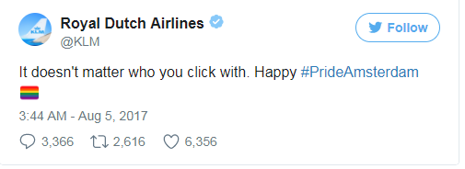

Slide 130
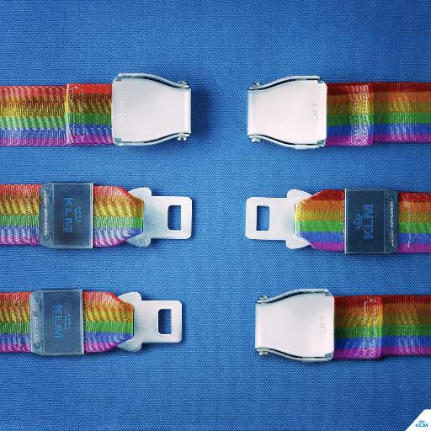

Slide 131
Doug Mainwaring, Airline botches pro-gay ad, proves marriage is only between man and woman
The bottom line is this: It is impossible to be on the right side of history — or science — while simultaneously on the wrong side of natural law. KLM Royal Dutch Airlines is helping the world understand this.

Slide 132
Canadian elementary school teachers attend 'LGGBDTTTIQQAAPP' inclusiveness training session. Would you understand the title?
Lesbian, Gay, Genderqueer, Bisexual, Demisexual, Transgender, Transsexual, Twospirit, Intersex, Queer, Questioning, Asexual, Allies, Pansexual and Polyamorous.

Slide 133
Tim Keller, Making Sense of God: An Invitation to the Skeptical, was asked this question:
Over the last 20 years in the West, what are the biggest shifts in topics and questions most relevant to “pre-evangelism”? What convinced you this sort of book was needed as opposed to simply leaving it at The Reason for God: Belief in an Age of Skepticism?
The main shift seems to be that sexuality, same-sex marriage, and gender are now “apologetics” issues. That wasn’t the case 20 years ago. They didn’t come up in talking to non-Christians, but today they almost always do.

Slide 134
In our present-day culture we are experiencing a moral-tsunami. One of the ways in which this is happening is in the realm of human sexuality. The notion of sex, gender and the fluidity of that is the accepted cultural narrative, especially as it relates to homosexuality and gender dysphoria. Those who affirm the Bible’s teaching and disagree with this cultural narrative are considered “cultural heretics.” It is important for us to know what the Bible says about this, how we think about this in the EFCA and how we respond with grace and truth, with convictional kindness.

Slide 135
Cultural Story/Narrative (Worldview)
Biblical Story/Narrative (Worldview)
Trans-curious
Trans-trending or Social Contagion (Trendy and Copycat)
Gender Stereotypes
Image and Identity
Post-truth and Confirmation Bias
Individual Expression, Authenticity, Personal Truth, and Acceptance

Slide 136
Imago Dei (the image of God)
Identity
Body
Purpose (telos)

Slide 137
Discernment is not knowing the difference between right and wrong. It is knowing the difference between right and almost right. C.H. Spurgeon

Slide 138
“At the heart of the transgender narrative is the destructive idea that your mind ‘can be at war with your body.’ It sets up an opposition between the body and the self, estranging people from their basic biological identities as male and female.” (Nancy Pearcey, “How the Transgender Narrative Perpetuates Stereotypes: The church can offer hope to those who find it hard to love the body they’re in.” Cf. Love Thy Body: Answering Hard Questions about Life and Sexuality.)

Slide 139
Andrew Walker, God and the Transgender Debate, “Tough Questions,” 145-159:
Can someone experience gender dysphoria and be a Christian?
Can someone be transgender and be a Christian?
Should parents keep their children in a public school if those schools promote transgenderism?
What should church elders (leaders) do if a congregation member asks for their child to be identified as the opposite gender (or neither gender)?

Slide 140
Is taking hormones to manage gender dysphoria ever appropriate?
Shouldn't we just focus on sins that are actually harming people (murder, adultery, etc.)? Transgenderism is harmless, isn't it?
Is it true that Christian teaching is harmful because not affirming a person's transgender identity leads to depression and higher rates of suicide?
How should we think about pronouns?
What about people who are born intersex (previously referred to as hermaphrodites)?

Slide 141
Key Historical (Cultural) Moments

Slide 142
Obergefell v. Hodges, June 26, 2015
Holding: The Fourteenth Amendment requires a state to license a marriage between two people of the same sex and to recognize a marriage between two people of the same sex when their marriage was lawfully licensed and performed out-of-state.
Judgment: Reversed, 5-4, in an opinion by Justice Kennedy on June 26, 2015. Chief Justice Roberts filed a dissenting opinion, in which Justices Scalia and Thomas joined. Justice Scalia filed a dissenting opinion, in which Justice Thomas joined. Justice Thomas filed a dissenting opinion, in which Justice Scalia joined. Justice Alito filed a dissenting opinion, in which Justices Scalia and Thomas joined.

Slide 143
Chief Justice John Roberts, in a dissenting opinion, wrote the following:
“Hard questions arise when people of faith exercise religion in ways that may be seen to conflict with the new right to same-sex marriage.”

Slide 144
June 12, 2016: “Omar Mateen, a 29-year-old security guard, killed 49 people and wounded 53 others in a terrorist attack/hate crime inside Pulse, a gay nightclub in Orlando, Florida.”
2016 Orlando nightclub shooting

Slide 145
In 2017, Disney portrayed its first gay character, in Beauty and the Beast. (March 17, 2017)

Slide 146
The General Synod of the Church of England has passed a motion on welcoming transgender people. (July 9, 2017)
That this Synod, recognising the need for transgender people to be welcomed and affirmed in their parish church, call on the House of Bishops to consider whether some nationally commended liturgical materials might be prepared to mark a person's gender transition.

Slide 147
Transgender Americans Won’t Be Allowed to Serve in Military, Trump Announces, Fred Lucas, July 26, 2017
5 Good Reasons Why Transgender Accommodations Aren’t Compatible With Military Realities, Ryan T. Anderson
Presidential Memorandum for the Secretary of Defense and the Secretary of Homeland Security (August 25, 2017): Military Service by Transgender Individuals

Slide 148
“Sex transition surgeries and hormone treatments could cost taxpayers about $3.7 billion over the next decade, according to the Family Research Council.” Cf. Transgender Policy Could Cost Military Billions Over Ten Years

Slide 149
Masterpiece Cakeshop, Ltd. v. Colorado Civil Rights Commission
History: In July 2012, Charlie Craig and David Mullins went to Masterpiece Cakeshop in Lakewood, CO, and requested that its owner, Jack C. Phillips, design and create a cake for their wedding. Phillips declined to do so on the grounds that he does not create wedding cakes for same-sex weddings because of his religious beliefs. Phillips believes that decorating cakes is a form of art through which he can honor God and that it would displease God to create cakes for same-sex marriages.

Slide 150
SCOTUS No. 16–111. Argued December 5, 2017—Decided June 4, 2018.
Held: The Commission’s actions in this case violated the Free Exercise Clause.

Slide 151
In a case that portends the future of parental rights, a judge in Ohio gives grandparents custody of a transgender teen.
Because of a dispute over whether a teenage boy who identifies as a girl should be allowed to undergo hormone treatment to “transition,” an Ohio judge gave custody of the 17-year-old to the boy’s grandparents.
According to CNN, the parents refused to call the boy by his chosen name and would not allow him to undergo hormone treatment. The parents’ attorney had argued that the child was not “even close to being able to make such a life-altering decision at this time,” while the county prosecuting attorney argued the parents wanted to stop the treatment because it violated their religious beliefs.

Slide 152
The judge not only gave custody of the teen to the grandparents, but said they could legally change his name in probate court and could help make medical decisions for the child going forward.
The judge also encouraged Ohio lawmakers to create legislation giving the judicial branch a framework in which they can evaluate a patient’s right to transgender medical interventions.
Why Transgenderism Threatens Parental Rights (February 20, 2018)
Cf. Judge paves way for transgender teen to get hormone therapy at Cincinnati Children's Hospital (February 16, 2018)

Slide 153
“Boy Scouts Changing Name To 'Scouts BSA,' As Girls Welcomed Into Program,” NPR (May 2, 2018)
The Boy Scouts program is becoming Scouts BSA in February 2019 to reflect the decision to include young women, the Boy Scouts of America announced on Wednesday. The organization's name will remain the same; only the program for older youth will change its name.

Slide 154
James Masters, “Martina Navratilova criticized for comments about trans women in sport”
John Stonestreet, BreakPoint: Navratilova, Identity Politics, and Intersectionality
  “You can’t just proclaim yourself a female and be able to compete against women . . . There must be some standards and having [male genitalia] and competing as a woman would not fit that standard.”
  “To put the argument at its most basic: a man can decide to be female, take hormones if required by whatever sporting organization is concerned, win everything in sight and perhaps earn a small fortune, and then reverse his decision and go back to making babies if he so desires.”
Navratilova was welcomed as a gay spokesperson when “came out” 1981. Today she is ostracized as TERF, a “trans-exclusionary radical feminist.”

Slide 155
Martina Navratilova, Update on recent Transgender Debate

Slide 156
General Session of the United Methodist Church (February 23-26, 2018)
Jeremy Steele, “United Methodists Vote to Keep Traditional Marriage Stance”
Emma Green, “Conservative Methodists Just Retook the United Methodist Church”
Dr. Jerry Kulah, an African delegate who is a professor at the United Methodist University in Liberia said,
  We Africans are not children in need of western enlightenment when it comes to the church’s sexual ethics. We do not need to hear a progressive U.S. bishop lecture us about our need to “grow up”…
  We are grounded in God’s word and the gracious and clear teachings of our church. On that we will not yield! We will not take a road that leads us from the truth! We will take the road that leads to the making of disciples of Jesus Christ for transformation of the world!…

Slide 157
“On Wednesday (March 13), Democrats in the U.S. Senate and House of Representatives introduced the Equality Act, a proposal that would add "sexual orientation" and "gender identity" to the classifications protected in federal civil rights law [added to the list of protected classes in the 1964 Civil Rights Act]. "Sexual orientation" includes homosexuality and bisexuality, while "gender identity" refers to the way a person perceives himself regardless of his biology at birth.

Slide 158
The Equality Act updates the definitions of three terms:
-"sex" to include a sex stereotype, sexual orientation or gender identity, and pregnancy, childbirth, or a related medical condition
-"sexual orientation" as homosexuality, heterosexuality, or bisexuality
-"gender identity" as gender-related identity, appearance, mannerisms, or characteristics, regardless of the individual's designated sex at birth.

Slide 159
The Equality Act expands the categories of "public accommodations" to include places or establishments that provide:
-exhibitions, recreation, exercise, amusement, gatherings, or displays
-goods, services, or programs, including a store, a shopping center, an online retailer or service provider, a salon, a bank, a gas station, a food bank, a service or care center, a shelter, a travel agency, a funeral parlor, or a health care, accounting, or legal service
-transportation services
The Equality Act prohibits "establishment" from being construed to be limited to a physical facility or place.

Slide 160
The bill as introduced today includes:
-It forbids all employers, even churches and religious non-profits, from “discriminating” on the basis of sexual orientation and gender identity in employment.
-It denies federal financial assistance to any organization (including religious colleges getting Title IV money) that “discriminate” on the basis of SOGI.
-It forces religious adoption and foster placement agencies to place children with same-sex couples.
-It forces almost all places of public accommodation (including some religious non-profits) to comply with a SOGI non-discrimination rule.
-It forces all landlords and other housing providers (including religious non-profits) to comply with a SOGI non-discrimination rule.

Slide 161
Andrew Walker, The Equality Act Accelerates Anti-Christian Bias
To be clear, Christians reject all forms of invidious discrimination. We believe all persons, including those who identify as LGBT, are made in God’s image and deserve respect, kindness, and neighborliness. But this truth does not necessitate Christian capitulation to the sexual revolution. No Christian who believes that the Bible’s depiction of created reality is both sacred and also authoritative can accept the Equality Act’s underlying tenets. By codifying the ideas that (1) sexuality has no core ethical limits other than consent, and that (2) male and female definitions are psychologically based, rather than biologically based, the Equality Act must be interpreted as an assault on Christian institutions and especially on parental rights—since public education will be transformed to follow the law’s provisions. It will further lead to the corrosion of our public discourse, the type of discourse that breeds zero-sum outcomes. One only has to look to Tim Gill (who infamously remarked that he intends to “punish the wicked”—those who fail to endorse LGBT politics) or Harvard law professor Mark Tushnet (who compared those who fail to endorse LGBT policies to Nazis) to see how fraught this conversation has become.

Slide 162
Cultural Images

Slide 163
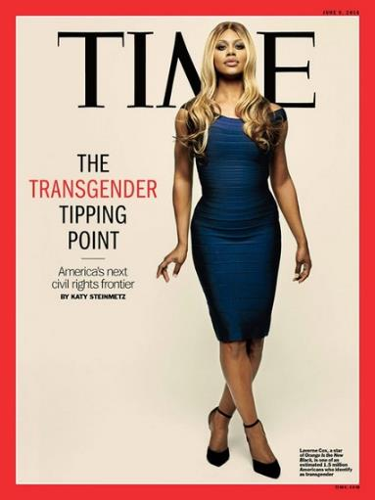
Laverne Cox, June 9, 2014

Slide 164
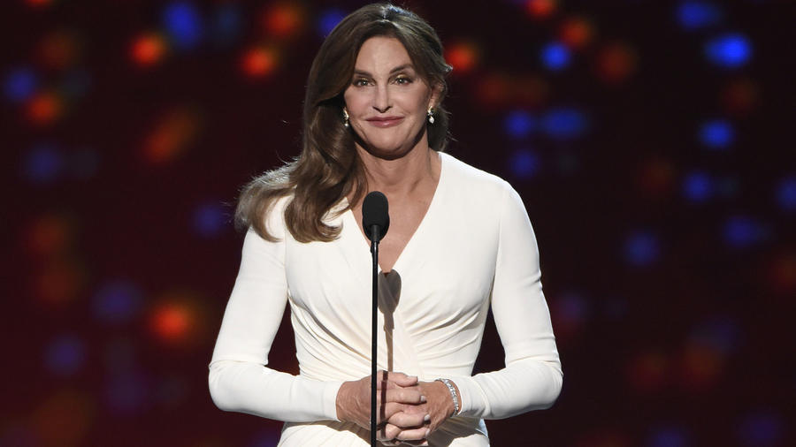
Caitlyn Jenner, Arthur Ashe Courage Award, July 2015

Slide 165
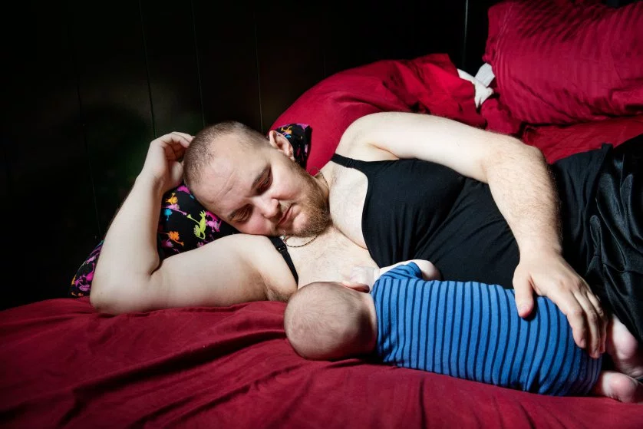
“My Brother’s Pregnancy and the Making of a New American Family,” TIME: Evan, who stopped his hormone treatments before trying to get pregnant, chest-feeds his newborn son in their Massachusetts home.

Slide 166
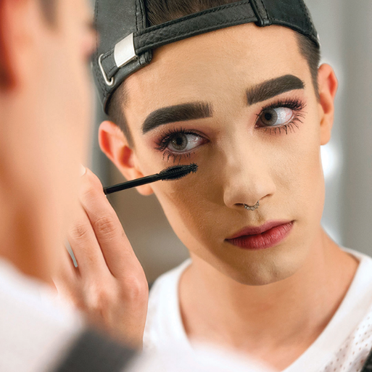
CoverGirl’s first CoverBoy: James Charles, October 2016

Slide 167
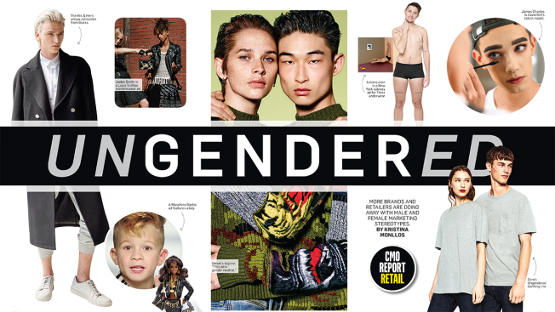
“Brands Are Throwing Out Gender Norms to Reflect a More Fluid World: Stereotypes won't work on younger consumers” Adweek

Slide 168
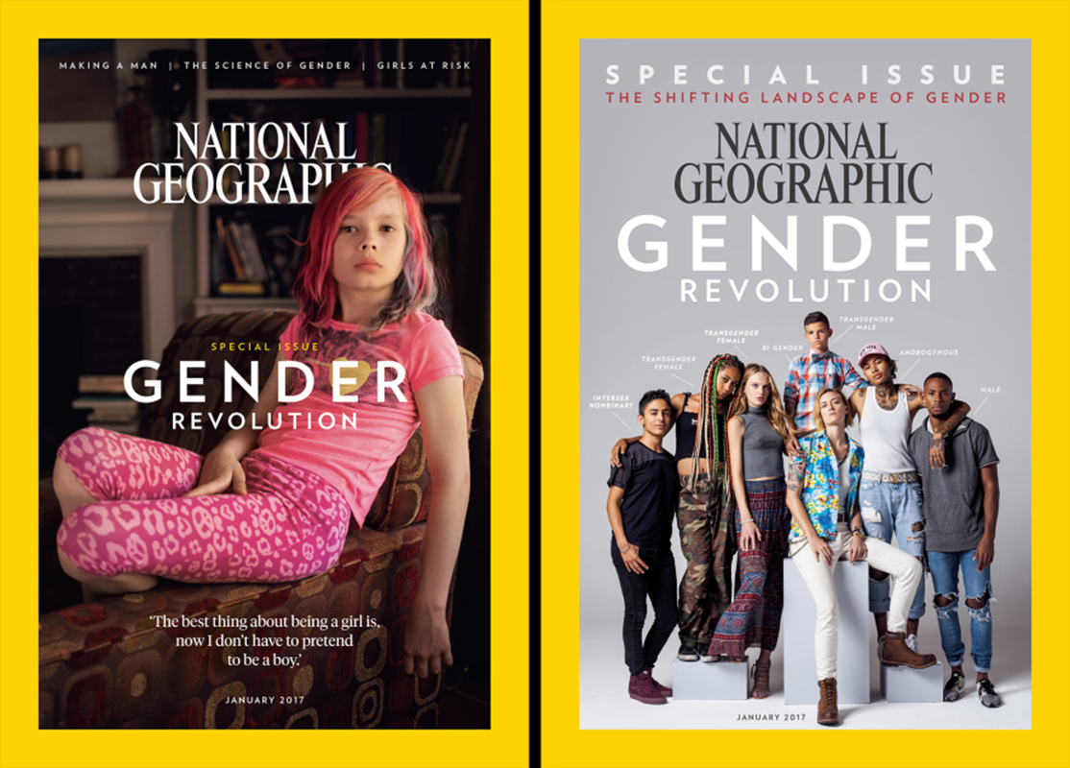
National Geographic, January 2017

Slide 169
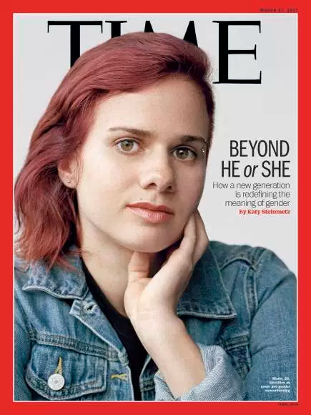
TIME, “Beyond ‘He’ or ‘She’”: How a New Generation is Redefining the Meaning of Gender (March 2017)

Slide 170

When Children Say They’re Trans: Hormones? Surgery? The choices are fraught—and there are no easy answers. The Atlantic (June 2018)

Slide 171

Jazz Jennings thanks fans after gender confirmation surgery (June 29, 2018)

Slide 172
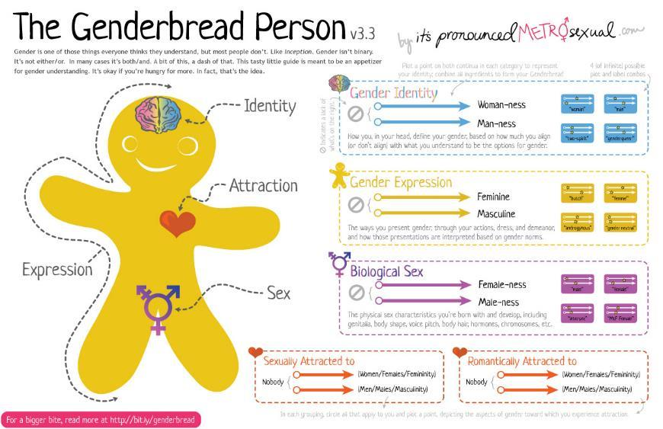

Slide 173
Ryan Anderson, Transgender Ideology Is Riddled With Contradictions. Here Are the Big Ones.

Slide 174
There’s “gender identity,” which is “how you, in your head, define your gender, based on how much you align (or don’t align) with what you understand to be the options for gender.” The graphic lists “4 (of infinite)” possibilities for gender identity: “woman-ness,” “man-ness,” “two-spirit,” or “genderqueer.”
The second characteristic is “gender expression,” which is “the way you present gender, through your actions, dress, and demeanor.” In addition to “feminine” or “masculine,” the options are “butch,” “femme,” “androgynous,” or “gender neutral.”

Slide 175
Third is “biological sex,” defined as “the physical sex characteristics you’re born with and develop, including genitalia, body shape, voice pitch, body hair, hormones, chromosomes, etc.”
The final two characteristics concern sexual orientation: “sexually attracted to” and “romantically attracted to.” The options include “Women/Females/Femininity” and “Men/Males/Masculinity.” Which seems rather binary.
The Genderbread Person tries to localize these five characteristics on the body: gender identity in the brain, sexual and romantic attraction in the heart, biological sex in the pelvis, and gender expression everywhere.

Slide 176
The Genderbread Person presented here is version 3.3, incorporating adjustments made in response to criticism of earlier versions. But even this one violates current dogma. Some activists have complained that the Genderbread Person looks overly male.
A more serious fault in the eyes of many activists is the use of the term “biological sex.”

Slide 177
According to Trans Student Education Resources, “Biological sex is an ambiguous word that has no scale and no meaning besides that it is related to some sex characteristics. It is also harmful to trans people. Instead, we prefer ‘sex assigned at birth’ which provides a more accurate description of what biological sex may be trying to communicate.”
The Gender Unicorn is the graphic that children are likely to encounter in school. These are the dogmas they are likely to be catechized to profess.

Slide 178
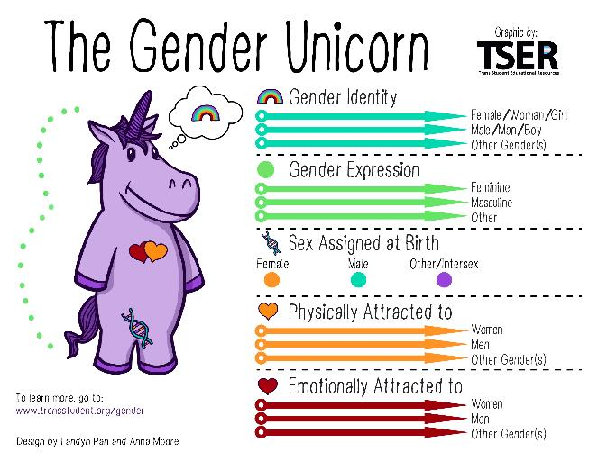

Slide 179
The Gender Unicorn is used to avoid a male or female body as default.
While activists claim that the possibilities for gender identity are rather expansive—man, woman, both, neither—they also insist that gender identity is innate, or established at a very young age, and thereafter immutable.

Slide 180
If gender is a social construct, how can gender identity be innate and immutable? How can one’s identity with respect to a social construct be determined by biology in the womb? How can one’s identity be unchangeable (immutable) with respect to an ever-changing social construct? And if gender identity is innate, how can it be “fluid”?
The challenge for activists is to offer a plausible definition of gender and gender identity that is independent of bodily sex.
Is there a gender binary or not? Somehow, it both does and does not exist, according to transgender activists. If the categories of “man” and “woman” are objective enough that people can identify as, and be, men and women, how can gender also be a spectrum, where people can identify as, and be, both, or neither, or somewhere in between?
What does it even mean to have an internal sense of gender? What does gender feel like? What meaning can we give to the concept of sex or gender—and thus what internal “sense” can we have of gender—apart from having a body of a particular sex?

Slide 181
Apart from having a male body, what does it “feel like” to be a man? Apart from having a female body, what does it “feel like” to be a woman? What does it feel like to be both a man and a woman, or to be neither?
The challenge for the transgender activist is to explain what these feelings are like, and how someone could know if he or she “feels like” the opposite sex, or neither, or both.
Even if trans activists could answer these questions about feelings, that still wouldn’t address the matter of reality. Why should feeling like a man—whatever that means—make someone a man? Why do our feelings determine reality on the question of sex, but on little else? Our feelings don’t determine our age or our height. And few people buy into Rachel Dolezal’s claim to identify as a black woman, since she is clearly not.

Slide 182
If those who identify as transgender are the sex with which they identify, why doesn’t that apply to other attributes or categories of being? What about people who identify as animals, or able-bodied people who identify as disabled? Do all of these self-professed identities determine reality? If not, why not?
And should these people receive medical treatment to transform their bodies to accord with their minds? Why accept transgender “reality,” but not trans-racial, trans-species, and trans-abled reality?
The challenge for activists is to explain why a person’s “real” sex is determined by an inner “gender identity,” but age and height and race and species are not determined by an inner sense of identity.

Slide 183
On the one hand, transgender activists want the authority of science as they make metaphysical claims, saying that science reveals gender identity to be innate and unchanging. On the other hand, they deny that biology is destiny, insisting that people are free to be who they want to be.
Which is it? Is our gender identity biologically determined and immutable, or self-created and changeable? If the former, how do we account for people whose gender identity changes over time? Do these people have the wrong sense of gender at some time or other?
And if gender identity is self-created, why must other people accept it as reality? If we should be free to choose our own gender reality, why can some people impose their idea of reality on others just because they identify as transgender?

Slide 184
At the core of the ideology is the radical claim that feelings determine reality. From this idea come extreme demands for society to play along with subjective reality claims. Trans ideologues ignore contrary evidence and competing interests, they disparage alternative practices, and they aim to muffle skeptical voices and shut down any disagreement.
The movement has to keep patching and shoring up its beliefs, policing the faithful, coercing the heretics, and punishing apostates, because as soon as its furious efforts flag for a moment or someone successfully stands up to it, the whole charade is exposed. That’s what happens when your dogmas are so contrary to obvious, basic, everyday truths.

Slide 185
Here's a List of 58 Gender Options for Facebook Users (2014), to which they added and are now at 71 Gender Options (2016).
Tinder update includes 37 new gender identity options (Tinder is an app, similar to e-harmony, but for looking for hookups)

Slide 186
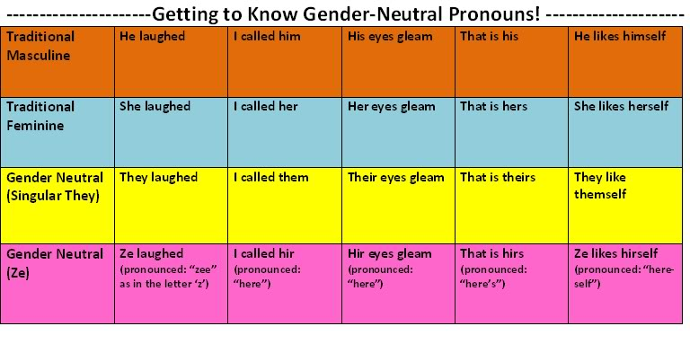
Gender-Neutral Pronouns
Carlton College, Sexuality and Gender Activism club

Slide 187
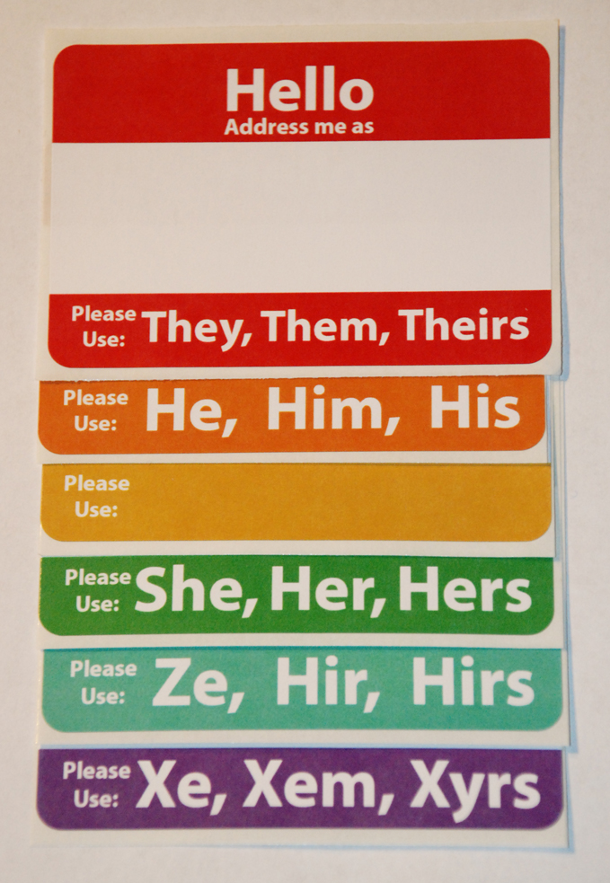
Set of 5 Hello Pronouns Stickers

Slide 188
Summary of Cultural Influences and Impacts
  Entertainment
  News Media
  Pop Culture
  Education
  Laws (Sexual Orientation and Gender Identity – SOGI)
  Businesses

Slide 189
Andrew Walker, The Transgender Question and the Challenge to Your Church
Are our churches ready and willing to be the communities our Lord calls us to be – both compassionate and truthful? A church should be the safest place to talk about, be open about, and struggle with gender dysphoria. That’s because the place where Jesus expects people to experience the truth of His promises is in His community – the church.

Slide 190
What is the cultural story/narrative? What is communicated as “truth”?
What is the biblical story/narrative? What is communicated by God in his Word?
How do these stories/narratives compare and contrast?

Slide 191
Critical Cultural Pressure Points for the Church

Slide 192
Tim Keller, Making Sense of God: An Invitation to the Skeptical, was asked this question:
Over the last 20 years in the West, what are the biggest shifts in topics and questions most relevant to “pre-evangelism”? What convinced you this sort of book was needed as opposed to simply leaving it at The Reason for God: Belief in an Age of Skepticism?
The main shift seems to be that sexuality, same-sex marriage, and gender are now “apologetics” issues. That wasn’t the case 20 years ago. They didn’t come up in talking to non-Christians, but today they almost always do.

Slide 193
But I don’t think that’s actually the main shift. The biggest difference is that Christianity used to have cultural familiarity and modest respect. Most Americans not only had a rudimentary knowledge of Christianity but also tended to respect it, or at least feel they ought to show some respect. Also, 20 years ago, the hyper-individualistic narratives (“You have to be true to yourself”; “No one has the right to tell anyone else how to live”) weren’t as deeply entrenched in as many people. Today Christianity is culturally strange and not respected. This is the world in which we share our faith now.

Slide 194
Today’s gender ideologues teach other confusing (and sometimes contradictory) ideas, such as:
  Gender is a social construct;
  Men and women aren’t different;
  People can change from one sex to the other;
  A person can be male, female, neither or some combination of the two;
  Biological sex doesn’t matter – it’s what is in you head that does;
  An individual’s gender can be fluid and changeable; and
  A person might have multiple genders.
“When Transgender Issues Enter Your World: How Christians can respond with compassion, courage and truth”

Slide 195
In Bruce Jenner’s interview with Diane Sawyer, Jenner explains how Kim told him she was able to understand his transition. It was Kanye who broke it down for Kim saying he can have the most beautiful wife and daughter, but it doesn’t mean anything if he can’t be comfortable in his own skin.
“I can be married to the most beautiful woman, and I am. I could have the most beautiful daughter, and I have that. But I’m nothing if I can’t be me.” “3 Takeaways From Bruce Jenner’s Coming Out Interview,” TIME (April 24, 2015)

Slide 196
“Then Jesus told his disciples, ‘If anyone would come after me, let him deny himself and take up his cross and follow me. For whoever would save his life will lose it, but whoever loses his life for my sake will find it. For what will it profit a man if he gains the whole world and forfeits his soul? Or what shall a man give in return for his soul?’” (Matt. 16:24-26; Mk. 8:34-38; Lk. 9:23-26; cf. Tit. 1:16; Jude 4).

Slide 197
When many of his disciples heard it, they said, "This is a hard saying; who can listen to it?" But Jesus, knowing in himself that his disciples were grumbling about this, said to them, "Do you take offense at this? Then what if you were to see the Son of Man ascending to where he was before? It is the Spirit who gives life; the flesh is no help at all. The words that I have spoken to you are spirit and life. But there are some of you who do not believe." (For Jesus knew from the beginning who those were who did not believe, and who it was who would betray him.) And he said, "This is why I told you that no one can come to me unless it is granted him by the Father." After this many of his disciples turned back and no longer walked with him. So Jesus said to the twelve, "Do you want to go away as well?“ Simon Peter answered him, "Lord, to whom shall we go? You have the words of eternal life, and we have believed, and have come to know, that you are the Holy One of God.“ (John 6:60-69)

Slide 198
Conviction and compassion.
“Afterward Jesus found him in the temple and said to him, ‘See, you are well! Sin no more, that nothing worse may happen to you’” (Jn. 5:14).
“Jesus stood up and said to her, ‘Woman, where are they? Has no one condemned you?’ She said, ‘No one, Lord.’ And Jesus said, ‘Neither do I condemn you; go, and from now on sin no more’” (Jn. 8:10-11).

Slide 199
Jamie Dean, “Suffer the Children,” World (April 15, 2017): “Some say the growing rush to label children ‘transgender’ promotes physician-approved child abuse. But speaking out against the practice provokes ire. Who will defend the vulnerable?”
Sophia Lee, “Sounding the Alarm,” World (April 15, 2017): “Many transgender persons regret what they did to their bodies and souls, and some are pleading that others not repeat the mistake.”

Slide 200
Sophia Lee, “Walt’s Story,” World (April 15, 2017): “Walt Heyer is a man again, and he has a manly purpose: protect the vulnerable from the transgender movement.”

Slide 201
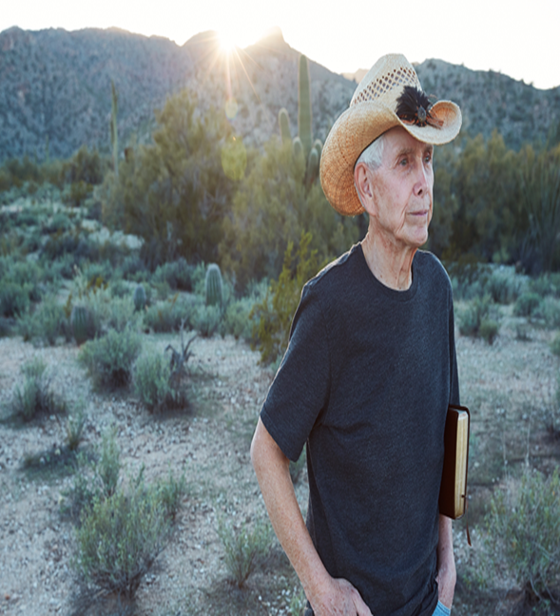
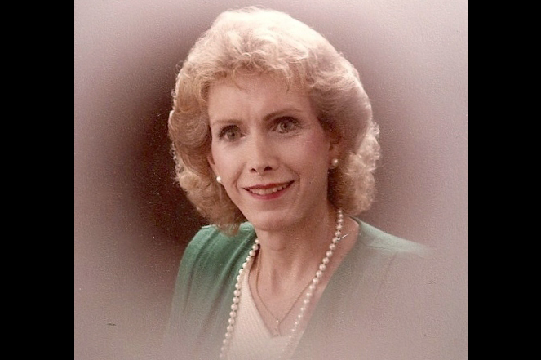

Slide 202
Carole Glines, '20/20' Recap: Caitlyn Jenner confirms she underwent 'final surgery' in gender reassignment (April 22, 2017)
Caitlyn Jenner told Diane Sawyer that she had undergone "the final surgery" in her gender reassignment procedures on Friday night's "20/20" special.
And Jenner said on the ABC interview, she had "no regrets, none whatsoever.“
Sporting red nails and stylishly feminine clothing, Jenner recalled how—when he was still known as Bruce--he had put an instruction in his will: "When I'm buried, I want to be dressed as her 'cause that's the way I'm going to heaven."
Although Jenner has had her jawline, forehead, and breasts worked on, she insists she's always been a woman because what's important is "what's between your ears."

Slide 203
Sophia Lee, “Lost in the Celebration,” World 32/11 (June 10, 2017): “Nobody hears much about family members who are often deeply affected by transgendered decisions.”

Slide 204
All of us struggle with how to respond to and engage with the LGBTQIA community. This is especially true since it is reflective of some major cultural shifts happening, accompanied by legal changes. There are those within the church struggling with this directly, and families of those who are struggling. From the statistics I know, the numbers are not large, but the struggle is real. However, this issue is mostly the pressure point of cultural engagement today, as we seek to understand and engage externally. For this reason, it is important for us to address.

Slide 205
A Few Important Statistics

Slide 206
The American Psychiatric Association (APA) estimates the numbers of transsexual adults as low as 0.005 to 0.014% of men (1 in 11,000) and 0.002 to 0.003% of women (1 in 30,000). These are probably low as they are based on the number of people who visit specialty clinics.
Among prepubescent children, the majority discover gender dysphoria decreases over time, and they will grow out of it. In fact, an estimated 75% of accurately diagnosed cases of gender dysphoria in childhood resolve by adulthood. However, many of them will identify as homosexual or bisexual.

Slide 207
People who identify as gender dysphoric are at a high risk for mental health problems. The attempted suicide rate is 41% of those that identify as struggling with gender dysphoria, much higher than for the general population.
This compares with a 4.6% suicide attempt rate of the overall U.S. population, and the 10-20% of lesbian, gay and bisexual adults who report ever attempting suicide.
“Suicide attempts among trans men (46%) and trans women (42%) were slightly higher than the full sample (41%),” cf. Suicide Attempts among Transgender and Gender Non-Conforming Adults

Slide 208
Those who have had transition surgery are 19 times more likely than average to die by suicide: “Persons with transsexualism, after sex reassignment, have considerably higher risks for mortality, suicidal behaviour, and psychiatric morbidity than the general population.” Cf. Long-Term Follow-Up of Transsexual Persons Undergoing Sex Reassignment Surgery
There is a growing movement in culture and government to consider transgender rights as civil rights. This is especially true post SCOTUS Obergefell decision (June 26, 2015). These are seen to be conflicting with religious freedom.
What causes gender dysphoria? No one knows for certain? Nature or nurture?

Slide 209
Andrew Marin, Us Versus Us (Colorado Springs: NavPress, 2016).
86% of LGBTs were raised in a faith community from the ages 0 to 18.
54% of LGBT people leave their religious community after the age of 18.
76% of LGBT people are open to returning to their religious community and its practices.
36% of LGBTs continue in their faith practices after the age of 18.
80% of LGBT people regularly pray regardless of religious identification or affiliation.

Slide 210
Terms And Definitions

Slide 211
L: Lesbian
G: Gay
B: Bisexual
T: Transgender
Q: Queer
I: Intersex
A: Ally
+: Other

Slide 212
Ontological Sex (biologically sexed): human person’s basic sexual identity as male or female.
Biological Sex/Birth Sex/Assigned Gender: male or female according to chromosomes, e.g., XX in females and XY in males, and internal and external (anatomy and) physiology.
Gender: psychological, social and cultural manifestation of maleness and femaleness.

Slide 213
Gender Identity: how a person perceives, experiences or thinks of him/herself as male or female, including how masculine or feminine you feel.
Gender Stereotype: how a culture perceives or identifies the boundary markers and lines, along with expectations, for the living out of biological sex societally and culturally.
Cisgender or Cis: someone whose gender identity is the same as their birth sex (or assigned at birth). Non-trans is also used.
Intersex (hermaphrodite): one who has been born with biological attributes of both sexes.

Slide 214
Non-binary: a person who does not identify as male or female.
Queer: one does not identify with traditional categories of gender identity and sexual orientation, used pejoratively in the past.
Gender Dysphoria (gender identity disorder): refers to deep and abiding discomfort over the incongruence between one’s biological sex and one’s psychological and emotional gender identity that does not match one’s biological/birth sex.

Slide 215
Transgender: this is an umbrella term for the many ways people might experience or present, express (or live out) their gender identities differently from people whose sense of gender identity is congruent with their biological/birth sex. Transgender man (trans man) refers to one whose birth sex is female but identifies and lives as a man. Transgender woman (trans woman) refers to one whose birth sex is male but identifies and lives as a woman.
Transsexual: a person who believes he or she was born in the “wrong” body (of the other sex) and wishes to transition (or has transitioned referred to as transitioning) through hormonal treatment and sex reassignment surgery.

Slide 216
Glorified Sex (Glorification): The final act of God in salvation when Christ returns and those believers who have died are now re-embodied and transformed and those believers who are alive will be instantaneously transformed, a time when there will be no more marriage (Matt. 22:30; Mk. 12:25; Lk. 20:34-35). However, our resurrection bodies will be sexed bodies, i.e., male and female, and Jesus will always be a crucified, circumcised male Jew forever.

Slide 217
Andrew T. Walker, What’s in a Name? Why Christians Should Be Wary of http://reformingcatholicconfession.com/the Word "Transgender“
The Christian worldview accepts the validity of people’s testimony that gender dysphoria is a real experience resulting in heartrending distress. The Christian worldview cannot, however, countenance the idea that men can become women or that women can become men. No amount of self-assertion or self-description, not matter the vehement sincerity, can result in individuals reconfiguring their chromosomes. Seen from this view, to exist as “transgender” is, itself, a social construct offered up by revisionists.

Slide 218
This is why simplistic or unwitting uses of the term “transgender” are problematic. The culture has intentions for the word that are incompatible with Christian anthropology. . . . “Transgender” is a neologism chock full of ideological assumptions that Christians cannot innocently use. . . . To be clear: individuals are not transgender. Individuals cannot be transgender. People are born male and female, with fallen desires, intuitions, and perceptions that lead the heart and mind astray.

Slide 219
Understanding Gender Dysphoria

Slide 220
Mark Yarhouse, Understanding Gender Dysphoria (cf. “Understanding the Transgender Phenomenon,” Christianity Today (June 2015). (For some of the other notes in this section, cf. Yarhouse lectures, NAE, “Pastoral Care of LGBT Persons and Their Families”; EFCA One All-Day Intensive, “The Gospel, Culture and Human Sexuality: LGBTQ+”)
Integrity Lens: “the sacred integrity of maleness or femaleness stamped on one’s body.” (Creation)

Slide 221
Disability Lens: “This lens views gender dysphoria as a result of living in a fallen world, but not a direct result of moral choice. Whether we accept brain-sex theory or another account of the origins of the phenomenon, if the various aspects of sex and gender are not aligning, then it’s one more human experience that is ‘not the way it’s supposed to be.’” (Fall and Redemption)
Diversity Lens: “This lens sees the reality of transgender persons as something to be celebrated, honored, or revered. Our society is rapidly moving in this direction.” (Fall denied)

Slide 222

Gay as Self-Defining Attribution:
Milestone Events
Typically a 3-4 year process for females; 5-6 years for males
Can range from months to as long as 15+ years
Initial Awareness of Attraction
Same-Sex
Behavior
Questioning
of Identity
Self-Defining
Attribution
(Gay Identity)

Slide 223
Navigating Terrain of Sexual Identity
13 years old 16-18 years old 19 years old
Awareness Behavior Relationship?
17 years old 18 years old
Attributions? Private Label?
Disclosure? Public Label?

Slide 224
How is this biblical truth communicated and lived out by Christians and the church?
What is the message given and heard by those who struggle with sexual identity?
How do we remain committed to grace and truth, to be welcoming but not affirming?

Slide 225
The Cultural Script

Slide 226
The cultural context of this discussion is framed by a gay and transgender script. Compare and contrast this with the biblical script for humanity. Which is more compelling to the person who is oriented or identifies as gay? What are the implications for Christians and the church?

Slide 227

The LGBTQ+ Community
Tends to be “family” to one another and show greater hospitality than most
A place for friendship and belonging
Provides role models for young Christian sexual minorities where Christian communities are often silent or are experienced as antagonistic

Slide 228
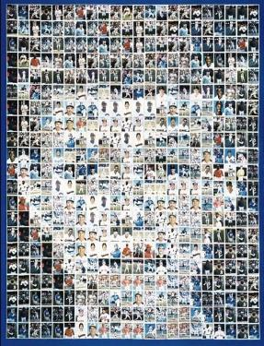
A Gay Script
Same-sex attractions signal a naturally-occurring distinction between types of people;
Same-sex attractions signal who a person "really is"...
Same-sex attractions are at the core of who you are as a person;
Behavior as an expression of who you are (identity);
Self-actualization of your sexual identity

Slide 229
A Transgender Script
Gender incongruence signals a distinction among types of people (Transgender, cisgender, and non-binary types of people),
Gender incongruence signals who a person “really is”…
Gender variation is at the core of who you are as a person;
Adopting a cross-gender or other gender identity is confirmation and expression of who you are;
Self-actualization of your gender identity

Slide 230
The Christian Script
God created male and female.
God’s creation is very good.
The Fall has changed everything.
Christ redeems and restores sinners.
Purpose, meaning, wholeness are found not going against God’s design, but following that design.

Slide 231
The Christian Script
In this design, the one who dies is the one who lives. It is costly obedience, for all.
This gives hope and provides a full and abundant life in Christ and with community.

Slide 232

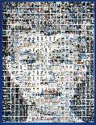
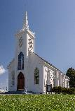
Sexual & Religious Identity Conflict
LGBTQ + Community
Local Faith Community
Resources to answer questions about identity, community

Slide 233
Sexual & Religious Identity Conflict
“Yes”
To identity
To community
To intimacy
To status
To…
LGBTQ + Community
Local Faith Community
Resources to answer questions about identity, community

Slide 234
Sexual & Religious Identity Conflict
“No”
To identity
To community
To intimacy
To status
To…
LGBTQ + Community
Local Faith Community
Resources to answer questions about identity, community

Slide 235
Sexual & Religious Identity Conflict
“Yes”
To identity
To community
To intimacy
To status
To…
“No”
To identity
To community
To intimacy
To status
To…
LGBTQ + Community
Local Faith Community
Resources to answer questions about identity, community

Slide 236
Sexual & Religious Identity Conflict
“Yes”
Humility
Compassion
Value Singleness
Biblical Hope
Costly Obedience for all
Family
Language
“Yes”
To identity
To community
To intimacy
To status
To…
“No”
To identity
To community
To intimacy
To status
To…
LGBTQ + Community
Local Faith Community
Resources to answer questions about identity, community

Slide 237
Bible

Slide 238
Homosexuality: Biblical Texts
Genesis 19 (Sodom)
Leviticus 18:22; 20:13 (Moral and Sexual Boundaries and Purity)
1 and 2 Samuel (1 Sam. 18:1, 4; 20:41; 2 Sam. 1:26) (David and Jonathan)
Mark 10:6-9 (Jesus’ Teaching on Marriage)
Romans 1:26-27 (Paul)
1 Corinthians 6:9-10 (Paul)
1 Timothy 1:9-10 (Paul)

Slide 239
Gender Dysphoria: Biblical Texts
Genesis 1:27 (Created Male and Female)
Deuteronomy 23:1; 22:5 (Crushed Testicles or Male Organ Cut Off will not enter the assembly of the Lord; Crossdressing God detests)
Matthew 19:12 (Eunuchs)
Acts 8:26-40 (Eunuch)
1 Corinthians 6:9-10 (Unrighteous will not Inherit the Kingdom of God)

Slide 240
Eliel Cruz, “Where in the Bible does it say you can’t be transgender? Nowhere,” The Washington Post (August 26, 2016).
“There is not a single verse in scripture that discusses transgender identities. Yet these Christians have decided that trans identities are sinful, mostly through their lack of understanding of what being trans means.”

Slide 241
“To use this verse to condemn transgender identities requires ignorance of transgender identities and laziness in interpretation. . . . But again, this requires a certain laziness in interpretation and is not consistent with the way that Christians interpret the rest of the Genesis account.”
“The biological and psychological reality of transgender and intersex individuals needs to be the context in which Christians read scripture.”

Slide 242
“I think the only reason we are having this debate is because of the so-called ‘clobber passages’ [Genesis 19:1-29; Leviticus 18:22; 20:13; Romans 1:26-27; 1 Corinthians 6:9-11; 1 Timothy 1:10-11] each one of which is somewhat obscure and addresses specific cultural matters of its time. If those passages weren’t in the Bible, nothing else that’s in the Bible would make us think God was against same-sex marriage.”
Justin Lee, author of Torn: Rescuing the Gospel from the Gays-vs.-Christians Debate (Jericho Books, 2012), founder of the Gay Christian Network (GCN)

Slide 243
The Story from Beginning to End
Wesley Hill, Why Do We Think the Bible is Against Same-Sex Marriage?
“I think there is a consistent Scriptural teaching on marriage—aptly summarized by Augustine’s three “goods” of fidelity/exclusivity, procreation, and sacrament, and traceable from Genesis to Revelation—and that the so-called “clobber passages” are merely ancillary confirmation that same-sex sexual intimacy is ruled out of bounds for Christian believers. Even without those passages, I’m convinced I’d still hold the views I hold about marriage: that is a covenantal bond between a man and a women, ordered to procreation, and bearing witness to Christ’s love for the church.”

Slide 244
“a marital form by which God orders human life, a form that is discernible in the unfolding of the biblical canon, from the first union of man and woman in Eden to the final marriage supper of the Lamb and his Bride, the church. And it is that figure as it is attested throughout Scripture, not just a handful of tricky verses in six or seven places in the Old and New Testaments, that is the ultimate reason many of us cannot see our way clear to affirm same-sex unions as Christianly appropriate.”

Slide 245
The Story from Beginning to End
N. T. Wright, What Is Marriage For?: Tracing God’s Plan from Genesis to Revelation
“The biblical view of marriage is part of the larger whole of new creation, and it symbolizes and points to that divine plan. . . . [Marriage] is setting up a signpost. We live in a world of many storms and many winds; those signposts can easily get battered and broken. But they are pointing somewhere – and the reality to which they are pointing is the fulfillment of God’s good purposes for creation. Marriage is a sign of all things in heaven and on earth coming together in Christ. That’s why it is a tough calling. But that is why, also, it is central and non-negotiable.”

Slide 246
Idolatry and Homosexual Behavior
The key correspondence [between idolatry on the one hand and homosexual behavior on the other] lies in the fact that both involve turning away from the ‘other’ to the ‘same’ . . . . Humanity should be oriented toward God but turns in on itself (Rom. 1.25). Woman should be oriented toward man, but turns in on itself (Rom. 1.26). Man should be oriented toward woman, but turns in on itself (Rom. 1.27).”
Simon Gathercole, “Sin in God’s Economy: Agencies in Romans 1 and 7,” in Divine and Human Agency in Paul and His Cultural Environment (T&T Clark, 2007), pp. 158-172, cf. pp. 163-164.

Slide 247
Wolfhart Pannenburg, Christianity Today (November 11, 1996), 37”
“If a church were to let itself be pushed to the point where it ceased to treat homosexual activity as a departure from the biblical norms, and recognized homosexual unions as personal partnership of love equivalent to marriage, such a church would stand no longer on biblical grounds but against the unequivocal witness of Scripture. A church that took this step would cease to be the one, holy, catholic, and apostolic church.”

Slide 248
S. Donald Fortson III (Author), Rollin G. Grams, Unchanging Witness: The Consistent Christian Teaching on Homosexuality in Scripture (B&H Academic, 2016), 5:
“On the issue of homosexual practice, no person or church or group should say that biblical texts mean something other than what the church has said all along because...both Scripture and the church have clearly and consistently said the same thing. The issue comes down to this: the authority of Scripture and the relevance of the church's teaching”

Slide 249
Biblical Story/
Narrative (Worldview)

Slide 250
Biblical Story/Narrative (Worldview)
  Creation: Genesis 1:26-28
  Fall: Genesis 2:16-17; Genesis 3
  Redemption: 1 Corinthians 6:9-11 (Revelation 22:12-16)
  Glorification: Philippians 3:20-21

Slide 251
Creation

Slide 252
Genesis 1:26-28
Then God said, "Let us make man in our image, after our likeness. . . .So God created man in his own image, in the image of God he created him; male and female he created them. And God blessed them. And God said to them, "Be fruitful and multiply and fill the earth and subdue it.”

Slide 253
Genesis 1:31
And God saw everything that he had made, and behold, it was very good. And there was evening and there was morning, the sixth day.

Slide 254
Genesis 2:15-18, 24-25
Then the LORD God said, "It is not good that the man should be alone; I will make him a helper fit for him.“. . . Therefore a man shall leave his father and his mother and hold fast to his wife, and they shall become one flesh. And the man and his wife were both naked and were not ashamed.

Slide 255
Fall

Slide 256
Genesis 3:1-6
Now the serpent was more crafty than any other beast of the field that the LORD God had made. He said to the woman, "Did God actually say, 'You shall not eat of any tree in the garden'?" . . . But the serpent said to the woman, "You will not surely die. For God knows that when you eat of it your eyes will be opened, and you will be like God, knowing good and evil."

Slide 257
Genesis 3:7-13
Then the eyes of both were opened, and they knew that they were naked. And they sewed fig leaves together and made themselves loincloths. And they heard the sound of the LORD God walking in the garden in the cool of the day, and the man and his wife hid themselves from the presence of the LORD God among the trees of the garden. But the LORD God called to the man and said to him, "Where are you?" And he said, "I heard the sound of you in the garden, and I was afraid, because I was naked, and I hid myself." He said, "Who told you that you were naked? Have you eaten of the tree of which I commanded you not to eat?" The man said, "The woman whom you gave to be with me, she gave me fruit of the tree, and I ate."

Slide 258
Genesis 3:14-21
Then the LORD God said to the woman, "What is this that you have done?" The woman said, "The serpent deceived me, and I ate." The LORD God said to the serpent, "Because you have done this, cursed are you above all livestock and above all beasts of the field; on your belly you shall go, and dust you shall eat all the days of your life. I will put enmity between you and the woman, and between your offspring and her offspring; he shall bruise your head, and you shall bruise his heel." To the woman he said, "I will surely multiply your pain in childbearing; in pain you shall bring forth children. Your desire shall be contrary to your husband, but he shall rule over you." And to Adam he said, "Because you have listened to the voice of your wife and have eaten of the tree of which I commanded you, 'You shall not eat of it,' cursed is the ground because of you; in pain you shall eat of it all the days of your life; thorns and thistles it shall bring forth for you; and you shall eat the plants of the field. By the sweat of your face you shall eat bread, till you return to the ground, for out of it you were taken; for you are dust, and to dust you shall return." The man called his wife's name Eve, because she was the mother of all living. And the LORD God made for Adam and for his wife garments of skins and clothed them.

Slide 259
Mark 7:18-23
And he said to them, "Then are you also without understanding? . . . . And he said, "What comes out of a person is what defiles him. For from within, out of the heart of man, come evil thoughts, sexual immorality, theft, murder, adultery, coveting, wickedness, deceit, sensuality, envy, slander, pride, foolishness. All these evil things come from within, and they defile a person."

Slide 260
Mark 8:31-38
And calling the crowd to him with his disciples, he said to them, "If anyone would come after me, let him deny himself and take up his cross and follow me. For whoever would save his life will lose it, but whoever loses his life for my sake and the gospel's will save it. For what does it profit a man to gain the whole world and forfeit his soul? For what can a man give in return for his soul? For whoever is ashamed of me and of my words in this adulterous and sinful generation, of him will the Son of Man also be ashamed when he comes in the glory of his Father with the holy angels."

Slide 261
John 10:9-10
I am the door. If anyone enters by me, he will be saved and will go in and out and find pasture. The thief comes only to steal and kill and destroy. I came that they may have life and have it abundantly.

Slide 262
Redemption

Slide 263
2 Corinthians 5:17
Therefore, if anyone is in Christ, he is a new creation. The old has passed away; behold, the new has come.

Slide 264
Romans 8:28-30
For those whom he foreknew he also predestined to be conformed to the image of his Son, in order that he might be the firstborn among many brothers. And those whom he predestined he also called, and those whom he called he also justified, and those whom he justified he also glorified.

Slide 265
Galatians 2:20
I have been crucified with Christ. It is no longer I who live, but Christ who lives in me. And the life I now live in the flesh I live by faith in the Son of God, who loved me and gave himself for me.

Slide 266
Colossians 1:15-20
all things were created through him and for him. And he is before all things, and in him all things hold together. And he is the head of the body, the church. He is the beginning, the firstborn from the dead, that in everything he might be preeminent.

Slide 267
Colossians 3:5-8b, 12a
Put to death therefore what is earthly in you: sexual immorality, impurity, passion, evil desire, and covetousness, which is idolatry. On account of these the wrath of God is coming. In these you too once walked, when you were living in them. But now you must put them all away . . . Put on then, as God's chosen ones, holy and beloved . . .

Slide 268
Romans 12:1-2
I appeal to you therefore, brothers, by the mercies of God, to present your bodies as a living sacrifice, holy and acceptable to God, which is your spiritual worship. Do not be conformed to this world, but be transformed by the renewal of your mind, that by testing you may discern what is the will of God, what is good and acceptable and perfect.

Slide 269
1 Corinthians 6:9-11
Or do you not know that the unrighteous will not inherit the kingdom of God? Do not be deceived: neither the sexually immoral, nor idolaters, nor adulterers, nor men who practice homosexuality, nor thieves, nor the greedy, nor drunkards, nor revilers, nor swindlers will inherit the kingdom of God. And such were some of you. But you were washed, you were sanctified, you were justified in the name of the Lord Jesus Christ and by the Spirit of our God.

Slide 270
Mark 10:26-31
"Then who can be saved?" Jesus looked at them and said, "With man it is impossible, but not with God. For all things are possible with God." Peter began to say to him, "See, we have left everything and followed you." Jesus said, "Truly, I say to you, there is no one who has left house or brothers or sisters or mother or father or children or lands, for my sake and for the gospel, who will not receive a hundredfold now in this time, houses and brothers and sisters and mothers and children and lands, with persecutions, and in the age to come eternal life. But many who are first will be last, and the last first."

Slide 271
Glorification

Slide 272
Philippians 3:20-21
But our citizenship is in heaven, and from it we await a Savior, the Lord Jesus Christ, who will transform our lowly body to be like his glorious body, by the power that enables him even to subject all things to himself.

Slide 273
Revelation 21:1-5
"Behold, the dwelling place of God is with man. He will dwell with them, and they will be his people, and God himself will be with them as their God. He will wipe away every tear from their eyes, and death shall be no more, neither shall there be mourning, nor crying, nor pain anymore, for the former things have passed away." And he who was seated on the throne said, "Behold, I am making all things new." Also he said, "Write this down, for these words are trustworthy and true."

Slide 274
Biblical Affirmations
A Church Statement on Human Sexuality: Homosexuality and Same-Sex “Marriage”
A Resource for EFCA Churches

Slide 275
1. Our views of this issue flow from our commitment to God (Dt. 6:5; Matt. 22:37-38) and to His Word (2 Tim. 3:16-17; cf. Dt.32:45-47; Matt. 4:4), as expressed in the first two articles of our Statement of Faith.

Slide 276
2. God created human beings as male and female (Gen. 1:27). The complementary, relational nature of the human race as “male and female” reflects the created order given by God when He created human beings “in His image” (Gen. 1:26-27; 5:1, 3; 9:6; 1 Cor. 11:7; Jms. 3:9; cf. Rom. 8:29; 2 Cor. 3:18; Eph. 4:23-24; Col. 3:10). It is with joy in our finitude that we are to receive the gift of being either male or female.

Slide 277
3. Scripture grants two life-enhancing options for sexual behavior: monogamous marital relations between one man and one woman (Gen. 1:27-28; 2:18, 21-24; Matt. 19:4-6; Mk. 10:5-8; cf. Heb. 13:4) or sexual celibacy (1 Cor. 7:7; Matt. 19:12). Either is a gift from God, given as He wills for His glory and the good of those who receive and rejoice in His gift to them.

Slide 278
4. In Scripture monogamous heterosexual marriage bears a significance which goes beyond the regulation of sexual behavior, the bearing and raising of children, the formation of families, and the recognition of certain economic and legal rights, all of which are important. Marriage between a woman and a man is emphatically declared in Scripture to create a “one flesh” union (Gen. 2:23-24; Matt. 19:5), which in turn signifies the mystery of the union between Christ and His body, the Church (Eph. 5:22- 33). This means that the foundational understanding of marriage is as a covenant grounded in promises between a man and a woman which finds its divinely intended expression in the “one flesh” union of husband and wife, and between the “one flesh” union of husband and wife and God (cf. Prov. 2:16-17; Mal. 2:14; Eph. 5:31-32).

Slide 279
5. All of human existence, including our sexuality, has been deeply damaged by the fall into sin (Gen. 3; Rom. 3:23; 5:12). We all are sinners, broken in some measure by this fall. Though Christians are rescued, reconciled, renewed and in process of being transformed, this brokenness also affects us in that we groan, as the whole creation, eager to experience final redemption knowing at present we live in a not-yet-glorified state (Rom. 8:22-23).

Slide 280
6. Everything, from our environment to our bodily genetic code, has been ravaged by sin and the fall. Whether the homosexual attractions people experience are the product of their environment, their genetics, or another source, they are not what God intends and so do not render homosexual behavior legitimate.

Slide 281
7. Temptation, including sexual attractions, is not sin. Sin is yielding to temptation. Jesus himself was tempted, yet without sin (Matt. 4:1-11, Heb. 4:15).

Slide 282
8. The Scriptures have much to say about sexual behavior, from the beautiful affirmations of the Song of Songs to the clear prohibitions found throughout the Bible (e.g., Rom. 13:13-14; 1 Cor. 5:1-2; 6:9-10, 15-18; Gal. 5:16-21; 1 Thess. 4:3-8). The Apostle Paul affirms that among believers “there must not be even a hint of sexual immorality” (Eph. 5:3). All homosexual behavior is specifically condemned as sin in both the Old Testament and the New Testament (Gen. 19:4-11[cf. 2 Pet. 2:6-7; Jude 7]; Lev. 18:22; 20:13; Judges 19:22-25; Rom. 1:24-27; 1 Cor. 6:9-11; 1 Tim. 1:8-11). This includes both male and female homosexual activity, both the more passive and more active roles in homosexual practice, and all varieties of homosexual acts.

Slide 283
9. The gospel is full of grace and truth. It is an offer of grace and forgiveness to sinners as well as a call to live a holy life. It empowers us in the struggle to resist sin, including the sin of homosexual practice (Rom. 1:16; 1 Cor. 6:9-11; Eph. 4:20-24; 1 Thess. 4:3-8; Tit. 2:11-13).

Slide 284
10. The church is to be a new community that resembles a family of brothers and sisters united in Christ by the power of the Holy Spirit displaying deep relationships of love (cf. 1 Cor. 12:12-13; Rom. 12:10; 1 Tim. 5:1-2). Celibacy and singleness is to be celebrated and affirmed within the church family.

Slide 285
Definition: “Marriage is the original and foundational institution of human society, established by God as a one-flesh, covenantal union between a man and a woman that is life-long (until separated by death), exclusive (monogamous and faithful), and generative in nature (designed for bearing and rearing children), and it is to reflect the relationship between Christ and the Church.”

Slide 286
Status Confessionis

Slide 287
Definition

Slide 288
“It is the state, or condition, of the Church, the society, the world, in which the Church must stand by and stand up: stand by her confession and stand up for the authority of the Word of God that she confesses.”
Harold O. J. Brown, Status Confessionis,” Touchstone (May/June 1999).

Slide 289
“It means that a particular doctrine is essential to who we are as a church. If something is status confessionis it means this is a make or break issue. It means that the church will not tolerate others views on this matter. It means that this is not an indifferent matter or one on which we can agree to disagree. It means that if we are to be faithful in confessing the gospel we must confess this.”
Kevin DeYoung, A Status Confessionis Issue

Slide 290
History

Slide 291
Lutheran, Melanchthon and Adiaphora (1563)
  Cf. Article X of the Formula of Concord and its Solid Declaration (from which texts this debate has proceeded), in The Book of Concord: The Confessions of the Evangelical Lutheran Church, ed. Robert Kolb and Timothy J. Wengert (Minneapolis: Fortress Press, 2000), 515-16, 635-40.
Dietrich Bonhoeffer and Nazism (1933-1945)
Reformed Church in South Africa and Apartheid (1948-1991)
  Cf. also Eugene TeSelle, “How Do We Recognize a Status Confessionis?” Theology Today 45 (April 1988): 71-78; Martin Schloemann, "The Special Case for Confessing: Reflections on the Casus Confessionis (Dar es Salaam 1977) in the Light of History and Systematic Theology," The Debate on Status Confessionis: Studies in Christian Political Theology, ed. Eckhart Lorenz (Geneva: Lutheran World Federation, 1983), 47-94; Joachim Guhrt, "Status Confessionis: The Witness of a Confessing Church," Reformed World 37 (December 1983): 301-8; and D. J. Smit, "What Does Status Confessionis Mean?" in A Moment of Truth: The Confession of the Dutch Reformed Mission Church, ed. G. D. Cloete and D. J. Smit (Grand Rapids: Eerdmans, 1984), 7-32, esp. 8-16.

Slide 292
Contemporary:
Biblical Sexuality

Slide 293
“The depositum of faith—the testimony of the apostles to the saving acts of God in Jesus Christ—attests to the truth. It calls for faith, but it does not need the improvement of our rationality or our imagination to make it better. God is not waiting for us to improve the gospel. But, it nonetheless remains the case that the gospel addresses each new historical-cultural situation, each new language system, each new set of symbolic references that emerge in history. And therefore the task we have in each moment of history is to accurately remember that apostolic witness and translate it into the terms of each new time and place. We have a special calling to take the Scripture and Tradition of ancient Christian orthodoxy and make sense out of it to people in our own time.”
Turning Hearts to the Fathers: A Conversation With Thomas C. Oden, Part one of two parts by Kenneth Tanner Touchstone 8/3 (Summer 1995)

Slide 294
“If I profess Christ with the loudest voice and clearest exposition every portion of the truth of God except precisely that little point which the world and the devil are at that moment attacking, I am not confessing Christ, however boldly I may be professing Christ. Where the battle rages, there the loyalty of the soldier is proved, and to be steady on all the battlefield besides, is mere flight and disgrace if he flinches at that point.”
Elizabeth Rundle Charles, The Chronicles of the Schoenberg Cotta Family (Thomas Nelson, 1864)
.

Slide 295
David Gushee, “Telling the Story of My Departure from American Evangelicalism”
“I now believe that incommensurable differences in understanding the very meaning of the Gospel of Jesus Christ, the interpretation of the Bible, and the sources and methods of moral discernment, separate many of us from our former brethren — and that it is best to name these differences clearly and without acrimony, on the way out the door.

Slide 296
“I also believe that attempting to keep the dialogue going is mainly fruitless. The differences are unbridgeable. They are articulated daily in endless social media loops.”

Slide 297
Andrew Walker, “‘Incommensurable Differences’ and the Future of the Christian Church’s Sexual Witness”
“This is the stark reality that evangelicalism must come to grips with. There is no “third way” possible. Everyone is going to have to pick a side. Sitting on the fence might be convenient for some people’s career, but the trajectory of where the West is headed will not countenance moderation when the canons of social justice require nothing short of celebrating LGBT orthodoxy.

Slide 298
“We in the West are in a moment of status confessionis. At such a time, the church must confess what is essential to its foundations or else risk letting in false teachers that would lead the flock astray (Matthew 7:15-20; Mark 13:22-23). So the true church will hold fast to biblical teaching no matter what the cost, and institutions parading themselves around as churches will capitulate to the reigning zeitgeist and reveal themselves for what they are — churches with no lampstands (Rev. 2:1-7).”

Slide 299
The pattern of how doctrine slides into theological liberalism (cf. Al Mohler, “Air Conditioning Hell: How Liberalism Happens,”):
First, a doctrine simply falls from mention.
Second, a doctrine is revised and retained in reduced from.
Third, a doctrine is subjected to a form of ridicule.
Fourth, a doctrine is reformulated in order to remove its intellectual and moral offensiveness.

Slide 300
Andrew Walker, A Church in Exile: Hillsong Shifts on Homosexuality
Steps of Regression on Moral Matters:
  Relativize the issue with other issues.
  Be uncertain about the issue.
  Refuse to speak publicly on the issue.
  Be indifferent toward the issue.
  Accept the issue.
  Affirm the issue.
  Require the issue.

Slide 301
Denny Burk, “Four Stages of “Evangelical” Affirmation of Gay Marriage”:
  Oppose gay marriage
  Oppose taking a stand on the question.
  Affirm gay marriage
  Vilify traditional marriage proponents

Slide 302
God and The Gay Christian
Matthew Vines

Slide 303
There are a few who claim to affirm the inerrancy and authority of the Bible, who claim to be Evangelicals and who affirm homosexuality and same-sex “marriage.” One of those individuals is Matthew Vines, who has written a book articulating and defending this view: God and the Gay Christian: The Biblical Case in Support of Same-Sex Relationships. There have been a number of good responses to this book.

Slide 304
Vines has also begun a ministry known as The Reformation Project.
Mission and Vision: “The Reformation Project is a Bible-based, Christian grassroots organization that works to promote inclusion of LGBT people by reforming church teaching on sexual orientation and gender identity. Our vision is of a global church that fully affirms LGBT people.”

Slide 305
Introduction, Reclaiming Our Light, and Chapter 1: A Tree and Its Fruit
Key statement: “My core argument is not simply that some Bible passages have been misinterpreted and others have been given undue weight. My larger argument is this: Christians who affirm the full authority of Scripture can also affirm committed, monogamous same-sex relationships.” (p. 3)

Slide 306
Chapter 2: Telescopes, Tradition, and Sexual Orientation
Key statement: “The telescope didn’t lead Christians to reject Scripture. It simply led them to clarify their understanding of Scripture.” (p. 24)

Slide 307
Chapter 3: The Gift of Celibacy
Key statement: “Christians throughout history have affirmed that lifelong celibacy is a spiritual gift and calling, not a path that should be forced on someone.” (p. 44)

Slide 308
Chapter 4: The Real Sin of Sodom
Key statement: “Decades ago, biblical scholars on both sides of the issue dismissed the idea that homosexuality was the sin of Sodom. Yet that belief still pervades our broader cultural consciousness, fueling negative attitudes toward gay people among Christians, and negative attitudes toward the Bible among gay people.” (p. 60)

Slide 309
Chapter 5: The Abominations of Leviticus
Key statement: “I’d like us to consider the reason why Christians don’t follow all the laws we see in the Old Testament, from its restrictions on food to its rules about clothing—and much more, including the death sentence for rebellious children. And then I’d like to look at the Old Testament prohibitions of male same-sex intercourse, as we seek to discern whether and why Christians should follow them today.” (p. 78)

Slide 310
Chapter 6: Excess Passion and Unnatural Acts in Romans
Key Statement: “Romans 1:26-27 is the most significant biblical passage in this debate. It is the longest reference to same-sex behavior in Scripture, and it appears in the New Testament. So was Bobby Griffith’s mother right when she cited this passage as a reason to reject his sexual orientation? What was Paul saying here? Was his intent to teach that gay Christians should be celibate for life, because their sexual orientation is broken and falls outside of God’s natural design?” (pp. 96-97)

Slide 311
Chapter 7: Will Gay People Inherit the Kingdom of God?
Key Statement: “In this chapter, we will go to the heart of a message that damages the witness of Christians and gives LGBT people a damaged perception of God. We will explore the original meanings of terms that are used to tell gay people they will be excluded from God’s kingdom. And it involves just two words.” (p. 117)

Slide 312
Chapter 8: The Biblical Argument for Marriage Equality
Key Statement: “In keeping with the focus of Ephesians 5, the essence of Christian marriage involves keeping covenant with one’s spouse in a relationship of mutual self-giving, which does not exclude same-sex couples.” (p. 143)

Slide 313
Chapter 9, What the Image of God Teaches Us about Gay Christians
Key Statement: “In what ways are we made in God’s image, and what does that mean for all of us, and for gay Christians in particular? If same-sex orientation can be shown to be consistent with the image of God, how would that affect our bigger discussion of lifelong, committed, same-sex relationships?” (p. 150)

Slide 314
Chapter 10, Seeds of a Modern Reformation
Key Statement: “What can affirming Christians do to be agents of transformation on this central issue of our time?” (p. 165)

Slide 315
Debating Bible Verses on Homosexuality

Slide 316
It is helpful and important to hear the interpretation of key biblical texts on this issue. In Debating Bible Verses on Homosexuality, two who claim to be Evangelicals and affirm the authority of the Scriptures, interpreted four key texts addressing this moral issue. Caleb Kaltenbach, author of Messy Grace and a child of gay parents, affirms marriage is between a man and a woman. Matthew Vines, author of God and the Gay Christian, claims “marriage” is not limited to a man and a woman. In the answers that follow, I begin with Vines’ interpretation which is followed by Kaltenbach’s. The Scripture texts are from the NIV, 1984.

Slide 317
ROMANS 1:26-27: Because of this, God gave them over to shameful lusts. Even their women exchanged natural relations for unnatural ones. In the same way the men also abandoned natural relations with women and were inflamed with lust for one another. Men committed indecent acts with other men, and received in themselves the due penalty for their perversion.

Slide 318
Matthew Vines
Paul is explicit that the same-sex behavior in this passage is motivated by lust. His description is similar to the common ancient idea that people “exchange” opposite-sex for same-sex relations because they are driven by out-of-control desire, not because they have a different sexual orientation. And while Paul labels same-sex behavior “unnatural,” he uses the same word to criticize long hair in men in 1 Corinthians 11:14, which most Christians read as a synonym for “unconventional.” Christians should continue to affirm with Paul that we shouldn’t engage in sexual behavior out of self-seeking lustfulness. But that’s very different than same-sex marriages that are based on self-giving love, and we shouldn’t conflate the two in how we interpret this text today.

Slide 319
Caleb Kaltenbach
In this passage, Paul, who was quite familiar with biblical and secular views of sexual orientation, says that having sex with someone of the same gender is a sin. Some interpret this passage as a reference to heterosexuals who exchanged their natural sexual orientation for that which was not natural to them. The word that Paul uses for “natural” is not referring to what is natural to a specific person, but rather what is natural in light of God's intent for the sexual design of humanity. Ultimately, the passage serves as an introduction to verses 28-32, where Paul lists many other general sins that ultimately show our need for the Gospel.

Slide 320
LEVITICUS 18:22: Do not lie with a man as one lies with a woman; that is detestable.

Slide 321
Matthew Vines
Christ fulfilled the Old Testament law, and the New Testament teaches that Christians should live under the new covenant rather than the old one. Consequently, this verse has never applied to Christians. For a man to lie with a man “as with a woman” violated the patriarchal gender norms of the ancient world, which is likely why Leviticus prohibited it. But the New Testament casts a vision of God’s kingdom in which the hierarchy between men and women is overcome in Christ. So not only is Leviticus’s prohibition inapplicable to Christians on its own, the rationale behind it doesn’t extend to Christians, either.

Slide 322
Caleb Kaltenbach
God’s prohibition always has positive intentions. While no longer under the Law, Christians see the Law as a moral compass with principles for holy living. The Bible doesn’t have middle ground on same-sex relationships, monogamous or not. God reserves sex for marriage between a man and woman, because sex is a unique foundation of intimacy. Imagine all the evils, struggles and pain that could be avoided in relationships if we really followed God’s principles. When sex is only seen as a benefit for individuals rather than a foundation of social structures, it becomes selfish and manipulative.

Slide 323
MATTHEW 19:3-6: Some Pharisees came to him to test him. They asked, “Is it lawful for a man to divorce his wife for any and every reason?” “Haven’t you read,” he replied, “that at the beginning the Creator ‘made them male and female’ and said, ‘For this reason a man will leave his father and mother and be united to his wife, and the two will become one flesh?’ So they are no longer two, but one. Therefore what God has joined together, let man not separate.”

Slide 324
Matthew Vines
Jesus responds to a question about divorce by emphasizing the permanence of the marriage bond. He was asked about a man and his wife, and he responds accordingly, by referring to male and female. Same-sex marriage wasn’t on the radar screen in the biblical world, so it’s not surprising that neither Jesus nor any of the biblical writers addresses it. Therefore, Christians today have to ask whether gay relationships can fulfill the core principles of Scripture’s teachings about marriage. Based on Jesus’ teaching here and other texts like Ephesians 5, the essence of Christian marriage involves keeping covenant with one’s spouse in order to reflect God’s covenant with us through Christ. That’s something same-sex couples can and do live out today.

Slide 325
Caleb Kaltenbach
Jesus says that marriage is between a man and a woman by quoting Genesis 1:27. He affirms that God created sexual distinction between man and woman and this distinction serves as part of the foundation for marriage (helping to make Adam and Eve suitable partners). Spiritually, this distinction ultimately points to Jesus and the cross, where Jesus (the bridegroom) would pledge his love for his church (the bride) on the cross. As Jesus' words are binding for today, remember that there was no individual in the Bible called to be celibate that was not honored by God, including Paul, John the Baptist and Jesus himself.

Slide 326
1 CORINTHIANS 6:9-10: Do you not know that the wicked will not inherit the kingdom of God? Do not be deceived: Neither the sexually immoral nor idolaters nor adulterers nor male prostitutes nor homosexual offenders nor thieves nor the greedy nor drunkards nor slanderers nor swindlers will inherit the kingdom of God.

Slide 327
Matthew Vines
In this text, Paul uses two Greek words—malakoi and arsenokoitai—that likely refer to some forms of male same-sex behavior, but not the modern concept of homosexuality. The predominant forms of same-sex behavior in the ancient world were sex between masters and slaves, sex between adult men and adolescent boys, and prostitution. In all those cases, men used sex to express power, dominance and lustfulness, not self-giving love and mutuality. Committed same-sex unions between social equals represent very different values than the types of same-sex behavior Paul would have had in view in 1 Corinthians 6.

Slide 328
Caleb Kaltenbach
These words are found in the Greek translation of Leviticus 18 (which is what Paul would've used as a source when writing this letter). His phrase “men who have sex with men” is the Greek word arsenokoitai. It's a compound: arseno means “a male,” and koitai means “bed.” The word means “male bed”—or homosexuality. Though what Paul says might be offensive, he never intended to impose these values on non-Christians. In the current debate of same-sex marriage, there's an imposition of a meta-narrative being imposed from non-Christians to Christians. Should we violate our conscience and teachings of Scripture because of an agenda that labels us narrow-minded? That seems like an unfair expectation to me.

Slide 329
In light of Vines’ interpretation, how would you interpret these texts? How would you respond to Vines?
I encourage you to think this through along with fellow leaders. It is important to know what God’s Word says, and how others, particularly those affirming same-sex “marriage,” which we believe the Bible condemns as sin, interpret these key texts. Our desire and prayer is noted in 1 Peter 3:15-16a: “in your hearts honor Christ the Lord as holy, always being prepared to make a defense to anyone who asks you for a reason for the hope that is in you; yet do it with gentleness and respect, having a good conscience.”

Slide 330
EFCA

Slide 331
We have a policy for credentialing: Homosexual Belief and Conduct (Both Male and Female) As It Pertains to Credentialing in the EFCA

Slide 332
God created male and female in His own image (Genesis 1:27 and 2:22-24). This “good” work, however, was corrupted by human sin (Genesis 3). One of the resulting manifestations of sin is homosexual practice, which is plainly condemned by God (Leviticus 18:22 and 20:13). As with other sinful acts, homosexual lust (male or female) is a degrading and unnatural passion (Romans 1:24-25) that brings grave consequences in this life (Romans 1:26-27), and those who practice a lifestyle characterized by homosexual sin are excluded from the kingdom of God (1 Corinthians 6:9-11 and 1 Timothy 1:9-10).

Slide 333
Despite the controversy among some over the origin of homosexual attraction, the Bible is explicitly clear that all sinful lusts and behaviors result from the fall of humanity into sin. All engaged in this sin must seek forgiveness and healing through Jesus Christ. Persons once involved in homosexual lusts and practices who have turned to Christ in repentance are “washed, sanctified and justified in the name of the Lord Jesus by the Spirit of God” (1 Corinthians 6:11).

Slide 334
We have a resource for churches: A Church Statement on Human Sexuality: Homosexuality and Same-Sex “Marriage” – A Resource for EFCA Churches

Slide 335
Never have the sexual ethics of our culture been more confused and contorted. Divorce is rampant; co-habitation before or instead of marriage has become normal; new technologies have made pornography immediately accessible; and the once inconceivable notion of same-sex "marriage" is now recognized by law in a growing number of jurisdictions. The need for a clear voice from the church on these matters is critical, both for the health of our own community and for our faithful witness to the world.

Slide 336
This Statement, drawn from Scripture as our ultimate authority, sets forth a Christian vision of human sexuality as a good gift of God. The divine design for sexual expression within the commitment of marriage between a man and a woman is fundamental to the well-ordering of human society and is integral to human flourishing. We desire to articulate this ethic as moral truth binding on us all while recognizing our need of God's grace and forgiveness in the ways that we all fall short of this divine ideal.

Slide 337
In June 2017 the EFCA Conference adopted a Resolution: Biblical Sexuality and the Covenant of Marriage

Slide 338
This Resolution consists of two key biblical truths. First, God created human beings uniquely in his image as male and female, which addresses God’s biologically sexed creation which is “very good,” and which grounds the truth we affirm about marriage. Second, God has designed marriage to be a covenantal relationship between one man and one woman.

Slide 339
NOW, THEREFORE, IT IS HEREBY RESOLVED AS FOLLOWS:
The Evangelical Free Church of America affirms that God created human beings uniquely in His image as male and female, and He has designed marriage to be a covenantal relationship between one man and one woman.
Adopted this 21st day of June, 2017 by the EFCA Conference in Austin, Texas.

Slide 340
Pastoral and Practical Implications

Slide 341
1. We Christians who attempt to follow biblical mandates on sex and marriage are not immune to expressing our own sexuality in sinful ways, for "all have sinned and fall short of God’s glory" (Rom. 3:23). We must always be mindful of this and humbly relate to others accepting that we all are fallen creatures.

Slide 342
2. At the same time, all human beings deserve to be treated with dignity and respect because each of us bears the image of God. An LGBTQIA person deserves this dignity and respect no less than any other, and we, as Christians, should demonstrate this in our thoughts, speech, and behavior. Speech, including humor, which demeans LGBTQIA people, has no place in the Christian community. Likewise, this means we oppose any mistreatment of those who identify as LGBTQIA.

Slide 343
3. We mourn with those who struggle with same sex attractions, and with their families, but as we grieve, we encourage behavior that follows the clear divine teachings of Scripture.

Slide 344
4. We must carefully distinguish between same-sex attraction, sinful lust, self-selected identification, and sexual behavior. It is not a sin to be tempted in the area of same gender sex. Jesus himself was tempted, yet without sin (Heb. 4:15). He sympathizes with our weaknesses, and he promises to provide a way of escape in every temptation (1 Cor. 10:13).

Slide 345
5. In some cases it may not be wrong for a person to self-identify as LGBTQIA. This may be a way for the person to identify the stable trajectory of the person’s sexual attractions or acknowledge the struggles she or he faces with same-sex attraction. However, such self-identification may in fact be sinful if it includes an insistence upon behaviors that express that attraction. Moreover, a believer's fundamental identification should be first as a person “in Christ” (2 Cor. 5:17; Eph. 2:4-10; cf. 1 Cor. 6:9-11); the prioritization of sexual identity must be seen as a form of idolatry.

Slide 346
6. Some heterosexual acts are sinful, but all homosexual acts are sinful according to Scripture. One may not equate morally a committed heterosexual relationship within marriage with a committed homosexual relationship.

Slide 347
7. Though recognizing that due to sin and human brokenness our experience of our sex and gender is not always as God the Creator originally designed, our recognition of our sex as male or female as a gift from God dictates that we cannot support or affirm the resolution of tension between a person's biological sex and experience of gender by the adoption of a psychological identity discordant with that person’s birth sex, nor support or affirm attempts to change via medical intervention one's given biological birth sex in favor of the identity of the opposite sex or of an indeterminate identity.

Slide 348
(We recognize that in rare cases some are born with both sets of sexual organs (intersex or hermaphrodites). This is another one of the implications of living in a fallen world, and another reminder that our sexuality has been deeply damaged by the fall. This primarily addresses those who self-select sex and/or gender.)

Slide 349
8. We in the Church must seek ways to minister to and support those among us who struggle with same-sex attractions, and those who have family members or others close to them who identify as LGBTQIA.

Slide 350
9. We in the Church must seek ways to reach out in love to those in our society who identify as LGBTQIA.

Slide 351
10. We regard marriage as a good creation of God, and marriage within the Church as a rite and institution tied directly to our foundational belief of God as creator who made us male and female. We also regard marriage as a sacred institution which images the mysterious and wonderful bond between Christ and His Church. To us, then, marriage is much more than merely a contract between two persons (a secular notion). It is a covenant grounded in promises between a man and a woman which finds its divinely intended expression in the “one flesh” union of husband and wife, and between the “one flesh” union of husband and wife and God (the divine design). We therefore will only authorize and recognize heterosexual marriages.

Slide 352
11. Recognizing the church as a family, we will seek ways to encourage deep spiritual friendships, with a special effort to include those who are single. We will model the counter-cultural reality that intimate, loving relationships need not be erotic.

Slide 353
Pastoral and Practical Responses

Slide 354
“Then Jesus told his disciples, ‘If anyone would come after me, let him deny himself and take up his cross and follow me. For whoever would save his life will lose it, but whoever loses his life for my sake will find it. For what will it profit a man if he gains the whole world and forfeits his soul? Or what shall a man give in return for his soul?’” (Matt. 16:24-26; Mk. 8:34-38; Lk. 9:23-26; cf. Tit. 1:16; Jude 4).

Slide 355
Kevin Miller, Consistent Sexual Sacrifice: It's simple. It's radical. And it's essential to supporting church members with gay longings.

Slide 356
When many of his disciples heard it, they said, "This is a hard saying; who can listen to it?" But Jesus, knowing in himself that his disciples were grumbling about this, said to them, "Do you take offense at this? Then what if you were to see the Son of Man ascending to where he was before? It is the Spirit who gives life; the flesh is no help at all. The words that I have spoken to you are spirit and life. But there are some of you who do not believe." (For Jesus knew from the beginning who those were who did not believe, and who it was who would betray him.) And he said, "This is why I told you that no one can come to me unless it is granted him by the Father." After this many of his disciples turned back and no longer walked with him. So Jesus said to the twelve, "Do you want to go away as well?“ Simon Peter answered him, "Lord, to whom shall we go? You have the words of eternal life, and we have believed, and have come to know, that you are the Holy One of God.“ (John 6:60-69)

Slide 357
Conviction and compassion.
“Afterward Jesus found him in the temple and said to him, ‘See, you are well! Sin no more, that nothing worse may happen to you’” (Jn. 5:14).
“Jesus stood up and said to her, ‘Woman, where are they? Has no one condemned you?’ She said, ‘No one, Lord.’ And Jesus said, ‘Neither do I condemn you; go, and from now on sin no more’” (Jn. 8:10-11).

Slide 358
Matthew 12:17-21:
This was to fulfill what was spoken by the prophet Isaiah: "Behold, my servant whom I have chosen, my beloved with whom my soul is well pleased. I will put my Spirit upon him, and he will proclaim justice to the Gentiles. He will not quarrel or cry aloud, nor will anyone hear his voice in the streets; a bruised reed he will not break, and a smoldering wick he will not quench, until he brings justice to victory; and in his name the Gentiles will hope."

Slide 359
A Taxonomy of Response
It might be helpful to consider a taxonomy of articulating and defending the biblical truth in relation to gender dysphoria as discussed and applied in different contexts. Consider four audiences, the first three within the church, the last one more culturally outside the church, at least the Evangelical church, with different goals in each of the audiences:

Slide 360
to instruct God’s people morally and to strengthen ethical resolve;
to instruct for the purpose of pastoral response and engagement;
to engage pastorally with individuals, that person in need, and families who are affected;
to respond to the gender activists, sometimes within the liberal church, and often those outside the church.

Slide 361
3 Groups of Individuals
POLITICAL
Assertive Advocate
Gay & TG Scripts
PUBLIC
Day-to-Day Living
Identity and Community
PERSONAL
Recovery?
Vocation?

Slide 362
Although Evangelicals affirm the absolute authority of the Bible and are aware of these various audiences and different purposes with each of them, there are differences in approach for each of these audiences. As a general rule, there will be agreement among Evangelicals on key, foundational biblical and theological truths, while there will be differences of emphases and applications.

Slide 363
Pastorally, we ought to ask the question:
  Is this a sincere struggle?
  Is this a matter of justice or advocacy?

Slide 364
Pastorally, we ought to respond with . . .
  Grace and Truth
  Conviction and Compassion (Convictional Kindness)

Slide 365
What does the church communicate?
  On the one end, there is an arrogant optimism.
  On the other end, there is cynical pessimism.
  For the Christian, we teach, affirm and live with a realistic biblical hope.

Slide 366
What Does it Mean to Contextualize the Gospel?
“…the process whereby Christians adapt the forms, content, and praxis of the Christian faith so as to communicate it to the minds and hearts of people with other cultural backgrounds.” -A. Scott Moreau

Slide 367
Gay as Self-Defining Attribution:
Milestone Events
Typically a 3-4 year process for females; 5-6 years for males
Can range from months to as long as 15+ years
Initial Awareness of Attraction
Same-Sex
Behavior
Questioning
of Identity
Self-Defining
Attribution
(Gay Identity)

Slide 368
Navigating Terrain of Sexual Identity
13 years old 16-18 years old 19 years old
Awareness Behavior Relationship?
17 years old 18 years old
Attributions? Private Label?
Disclosure? Public Label?

Slide 369
The LGBTQ+ Community
Tends to be “family” to one another and show greater hospitality than most
A place for friendship and belonging
Provides role models for young Christian sexual minorities where Christian communities are often silent or are experienced as antagonistic

Slide 370
A Gay Script
Same-sex attractions signal a naturally-occurring distinction between types of people;
Same-sex attractions signal who a person "really is"...
Same-sex attractions are at the core of who you are as a person;
Behavior as an expression of who you are (identity);
Self-actualization of your sexual identity

Slide 371
A Transgender Script
Gender incongruence signals a distinction among types of people (Transgender, cisgender, and non-binary types of people),
Gender incongruence signals who a person “really is”…
Gender variation is at the core of who you are as a person;
Adopting a cross-gender or other gender identity is confirmation and expression of who you are;
Self-actualization of your gender identity

Slide 372
The Christian Script
God created male and female.
God’s creation is very good.
The Fall has changed everything.
Christ redeems and restores sinners.
Purpose, meaning, wholeness are found not going against God’s design, but following that design.
In this design, the one who dies is the one who lives. It is costly obedience, for all.
This gives hope and provides a full and abundant life in Christ and with community.

Slide 373
Sexual & Religious Identity Conflict
LGBTQ + Community
Local Faith Community
Resources to answer questions about identity, community

Slide 374
Sexual & Religious Identity Conflict
“Yes”
To identity
To community
To intimacy
To status
To…
“No”
To identity
To community
To intimacy
To status
To…
LGBTQ + Community
Local Faith Community
Resources to answer questions about identity, community

Slide 375
Sexual & Religious Identity Conflict
“Yes”
Humility
Compassion
Value Singleness
Biblical Hope
Costly Obedience for all
Family
Language
“Yes”
To identity
To community
To intimacy
To status
To…
“No”
To identity
To community
To intimacy
To status
To…
LGBTQ + Community
Local Faith Community
Resources to answer questions about identity, community

Slide 376
What, then, are the questions the church and leadership ought to be asking? What teaching should they be doing? Here is what my friend, who has a son who is married who now lives as a woman:
  Understand that this family is dealing with a serious mental health issue and suicide risk (41% attempt suicide). This condition (regretfully) cannot be treated with medication.
  Educate yourselves and your congregation to accept and love this family, not make them feel outcast.
  From experience, the discussions always shift from Transgender to Gay discussions. These two are not the same. Please don’t draw us into the Gay discussion.

Slide 377
  The family feels embarrassed and fearful of ridicule and shame. Be compassionate and genuine.
  Please don’t draw us into a discussion on who sinned, the parent or the child. This is a result of the fall, don’t shift this to who is to blame (we already grieve enough).
  Families have to adjust to the recalibration. Moving through name changes (including legal name changes), gender pronoun changes, changing appearances etc. Even though we do not sanction what is done, we have no control over what our adult children do. But even though we grieve with and for them, they are still our child and we love them. We are always mindful that a suicide risk still exists.

Slide 378
In the EFCA we are grounded in the gospel and tethered to the text of Scripture. We are also deeply committed to living out this truth of Scripture. And we do so in a fallen-yet-redeemed-though-not-yet-glorified world. There is sin, hurt, and brokenness. And yet in the midst of this, the gospel offers hope. We engage in pastoral care not only to share God’s truth with others, but because it is our only hope, our only true way of flourishing as God ordained.

Slide 379
As we engage in pastoral ministry of the gospel in the local church in the moral realms of human sexuality and gender dysphoria, we are an outpost of heaven. We reflect God’s eschatological people who offer the hope of the gospel in a context of love produced by the gospel which reflects the now of the kingdom. And we are often reminded through our pastoral care of our groaning, which reflects the not-yetness of the kingdom, as we await final redemption.

Slide 380
Conclusion

Slide 381
Rosaria Butterfield, The Best Weapon Is an Open Door, writes,
If you believe that these are dangerous times, then you are right. The worldview du jour is called “intersectionality” — the belief that who you truly are is measured by how many victim-statuses you can claim, with human dignity only accruing through the intolerance of disagreement of any kind.
“Your best weapon is an open door.”
This has landed Christians squarely in a post-Christian world, where the highest achievement of personhood is this: the autonomous, independent individual finding meaning in nothing but himself. Thoughtful Christians know that the steady erasure of Christian tradition in the day-to-day fabric of life will mean, sooner or later, that Christians will find ourselves living like the early church in hostile Rome.
How tempting it is to withdraw. How easy it is to let fear rule our hearts as we shelter ourselves and our children from evil. How afraid we are to speak when our words, in spite of good intentions and biblical integrity, are declared hate speech. How ought we to live? Your best weapon is an open door.
But how? Especially if we have been burned before, how do we open our doors to the world?

Slide 382
Butterfield’s first point is to “learn to listen.” She writes,
Traditionally, Christians have been taught to share the gospel by starting with the good news that Jesus saves us from our sins. But we live in a world that does not believe it needs saving from sin. It believes it needs saving from its Christian neighbors.
Instead of starting with talk, we need to start by listening, and listening well. In post-Christian communities, your words may only seem as strong as your relationships. So learn to know your audience, and try to be some earthly good to them. Your best spiritual weapon is an open door, a set table, a fresh pot of coffee, and a box of Kleenex for the tears that spill. Because tears will spill.
Being available to neighbors means cutting back on your entertainment indulgences, building in margin time in your day, and budgeting to feed many more people than those who share your last name. Make sacrifices for your unsaved neighbors that mean something. Go out of your way for them.

Slide 383
Butterfield’s writing in the article is reflective of a new book she has written: The Gospel Comes with a House Key: Practicing Radically Ordinary Hospitality in Our Post-Christian World (Wheaton: Crossway, 2018).
For a couple of interviews about the book and what Christian hospitality means, cf. Rosaria Butterfield: Christian Hospitality Is Radically Different from ‘Southern Hospitality’; and Sneak Peek Interview: Rosaria Butterfield.
For a brief testimony of her conversion, cf. My Train Wreck Conversion

